Slide 1

St. James's Hospital
Cloud Migration Response
17th August 2023

Slide 2




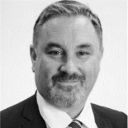


Engagement Leadership
17th August 2023
Brian Moroney Head of Digital and Emerging Tech
Email: brian.moroney@ie.ey.com Phone: +353 87 339 7633
Dear Patrick,
Thank you for giving us the opportunity to submit this proposal and to describe how we as a firm can assist you. The Health sector is one of the primary focuses for EY and we are fully dedicated to supporting your needs. We have supported numerous programmes across the Health sector, and we are keen to deepen our partnership with St. James's Hospital in this aspect, by assisting you in providing a Cloud Storage Technology Solution for the Pathology Laboratory.
We are approaching this engagement from the perspective of the best technical solution to meet your needs, with rapid value delivery to the organization as a key objective. Our solution will implement a fully managed future proofed solution that aligns to St. James's Hospital's requirement. We are proposing the use of Microsoft Azure services adhering to industry standards to build a viable solution. This will enable your teams to manage your operations by reducing the dependency on legacy systems and migrate to a platform that can deliver the right level of support at the right time at all instances.
Given our strong desire to further develop this partnership we are investing in a keenly-priced offer. We believe that this offer represents significant value to St. James's Hospital, and we’re confident that our team will deliver on time and within budget to the level of quality that St. James's Hospital expects. We trust that you see this quality reflected in our submission.
We are looking forward to your response and we are happy to discuss further how we can assist you. Please feel free to contact us if you have any questions or would like to explore any element of our proposal.
Kind regards
Ronan Walsh Brian Moroney Paul Browne
Paul Browne
Head of Microsoft & Cloud Services
Email: paul.browne@ie.ey.com Phone: +353 87 461 4137
Shane MacSweeney
Head of Government & Infrastructure
Email: shane.macsweeney@ie.ey.com Phone: +353
Ronan Walsh Head of Technology Consulting Email: ronan.walsh@ie.ey.com Phone: +353 87 373 3157

Slide 3

Contents
A. Executive Summary
B. Vendor Background
C. Proposal
D. Detailed Solution
E. Detailed Delivery Approach
F. Managed Service
G. Assumptions
H. Credentials
I. Our Team
J. Quality Assurance
K. Certifications
L. Appendix

Slide 4
A.
Executive Summary

Slide 5
Executive Summary
EY is firmly committed to working with St. James's Hospital to help deliver your Cloud Storage Technology transformation project based on Microsoft’s Azure Cloud platform, and to support you in an accelerated delivery that achieves your strategic objectives. Below are the key differentiators for why EY are the right partner for you on this journey.
Our Solution
Leveraging the Microsoft Cloud platform and the specific services it has to offer to meet your requirements.
Our Health Care Sector experience
We know and have extensive Health Care Sector experience, delivering transformation projects with excellence
We Have Extensive Microsoft Capabilities & Credentials
We are experts in supporting organizations transformation ambitions, leveraging Microsoft technologies, globally.
Our proposed solution is based on the use of Microsoft technologies, centred around Microsoft Azure and all the platform components Azure has to offer.
In addition to our technical capabilities, we bring strong, relevant experience of designing, building and running Health Care Sector transformation projects.
EY is one of the top Microsoft partners globally, providing a unique focus on transformation & implementation services with a strong value proposition in the domains of technology consulting and delivery.
Innovation
We challenge and offer innovation in every engagement we take on. From Day 1 we drive innovative methods of design, adoption, implementation and operations.​
Mature Managed Services Capabilities
We have a strong Managed Services capability delivered locally with many experienced professionals working in the Irish EY firm to support our delivery.
Our broad end-to-end technical capability
Our EY Technology Consulting practice has over 750 people across the full spectrum of technology delivery.
We take pride in our focus on client service and work alongside our clients to help solve complex problems. We will also constructively challenge the status quo where we see opportunities to improve.​
Our team in EY Ireland have been providing Managed Service support for over 10 years covering a wide suite of applications. EY’s Managed Service team is a responsive, local team focused on providing enterprise application and infrastructure support that’s secure, scalable and sustainable for your business.
The EY Technology Consulting practice covers the full breadth of technology transformation services from PM/BA, Digital Assurance, Cyber, Infrastructure, Engineering to a full mature managed service offering.

Slide 6


Our Understanding
Your objectives
You are seeking to partner with a proficient, collaborative, and forward thinking company that has readily available expert resources to deliver a Fully Managed Cloud Storage Technology Service for your Central Pathology Laboratory at Saint James’s Hospital. This will involve the migration of on-premise Molecular Testing patient data from five different national laboratories into a secure Cloud Storage environment, with the resilience and capacity for future use. Some of your high-level objectives are listed below:
Deliver a future-proofed solution that can handle Molecular testing patient data, analysis and storage (Hot & Cold) in a controlled manner.
Adding an additional layer of security to eliminate all the single points of failure present in the current locally based laboratorities.
Expand the existing backup processes for patient data.
Migration of laboratory data directly to Cloud.
Allow for individual laboratory connections and teams via Web between Genomics network and Cloud environment from dedicated SJH PC’s.
Migration of on-premise servers and databases to the Cloud
Utilise Quality Managed System during all stages of the solution delivery, including training of SJH resources, were and when required.
Our Understanding and Approach
We believe the delivery approach methodology we will follow and the solution we will implement, focusing on the following core components: IDAM, Connectivity, Backup, Compute, Data, Deployment Management, Recovery, Security, overall Governance and Quality Assurance throughout each stage of the engagement, are key to delivering a solution that will be fit-for-purpose and fulfil all the requirements set by SJH. Our proposed team brings continuity and a unique awareness of both the challenges and opportunities for planning, building, deploying and then supporting a critical solution for SJH.
Our Past Experience
Strong foundations built through past engagements will allow us to hit the ground running and deliver with maximum impact and efficacy.
CHI: EY delivered an end-to-end fully managed case management solution and contact centre service. The solution utilised the full breadth and depth of Microsoft’s Cloud Platforms including Power, Dynamics and Azure.
HSE: EY delivered an Azure Data Platform, enabling data integration from various sources to model the disease's (COVID-19) impact and offer situational dashboards for decision-making.
Screenlink: EY successfully migrated Screenlink legacy System to Microsoft Azure in 2020, resulting in upgraded servers, improved data security, and increased flexibility for future engagements.
Our Delivery Methodology
Using our tried and tested 6-stage Delivery methodology, we propose an agile 8-Month engagement with sprints following a 2-4 week pattern.
1
Prepare
Confirm purpose, vision and scope for the transformation. Kickstart solution design with industry templates and accelerators.
4
Realise: Test
Perform integrated testing of solution and train end users.
2
Explore
Perform fit-gap to leading practices and design delta solution for gaps, documenting requirements in a prioritised backlog of user stories.
5
Deploy
Cutover to production and deploy new solution.
3
Realise: Build
Build and unit test solution in time-boxed iterations based on prioritised backlog, load master data.
6
Run
Support new solution through hypercare and handover to service management.
Why EY
A strong track record
The right team to partner you
A proven approach
We have a strong track record of working within the Health Care sector, as shown within our Credentials, and delivering Technically complex Cloud Transformation solutions with an agile approach, for large scale organisations, similar in nature and scales as SJH.
Our delivery team is tailored to your needs and they are a team of locally based expert Microsoft Certified professionals, who are ready to deliver a solution for SJH, that is fit-for-purpose. We are inclusive and friendly to work with – while not being afraid to constructively challenge your thinking.
Our collaborative approach allows us to efficiently explore the big issues with stakeholders to build a shared vision. We also recognise the need for pragmatism, and that buy-in from stakeholders will be more critical than “ideological purity” of the solution.

Slide 7
B.
Vendor Background
B.1 – Overview of EY​
B.2 – Introduction to our Microsoft Tech capabilities​

Slide 8
B.1 – Overview of EY

Slide 9
Global headquarters
Professionals worldwide
Countries
B.1 – About EY
London
+365k
+150
EY worldwide — wherever you are
EY is one of the world's largest accounting and advisory organisations with 365,399 employees. Our employees in ca. 700 offices in +150 countries offer comprehensive professional expertise with globally uniform quality standards.
Our services — same high quality worldwide
We are a truly global partnership and we are committed to providing you with a truly seamless service in the following areas anywhere you may require it.
Most integrated and with global reach
Our management structure makes us the most integrated professional services firm worldwide. It allows us to align our people and activities better to meet clients’ demands for a consistent service quality worldwide while respecting the legal and regulatory requirements in each country. Another advantage of our integrated global structure is that we can better leverage our strengths. The engagement partners have ultimate authorization within the engagement team and hence have a unique global reach. We can move more swiftly to bring together the best teams to serve our accounts, drawing on all our expertise — across sectors, services and geographies.
EMEIA
141,307
people
Americas
91,189
people
Global
68,000 people
Asia-Pacific
64,903 people
Assurance | Tax | Consulting | Strategy and Transactions
Our Assurance services help to support organizations in promoting investor confidence, managing regulatory responsibilities and supporting long-term, sustainable economic growth. In doing so, we protect and serve the public interest and promote transparency. Audit Financial Accounting Consulting Services Forensic and Integrity Services | Our globally coordinated tax professionals offer connected services across all tax disciplines to help you thrive in an era of rapid change. Part of our global Tax practice is our Law practice, which is present in more than 70 countries. Business Tax International Tax Transaction Tax Tax related issues associated with people, compliance and reporting and law | Our Consulting practice works with some of the world’s largest and most complex multinational corporations, as well as with government organizations, on their most pressing management and operational challenges. Emerging Technologies Cybersecurity Digital Transformation Strategy & Risk Big Data and Analytics Purpose Led Transformation | Strategy and Transactions professionals around the world support a wide range of corporate, private capital and government clients to help them make better, more informed decisions on how to manage their capital agenda — Strategy Services Corporate Finance Buy and Integrate / Sell and Separate Reshaping Results Digital M&A Framework Infrastructure Advisory
112,019 professionals | 71,231 professionals | 109,571 professionals | 24,355 professionals

Slide 10
B.2 – Introduction to our
Health Sector

Slide 11
Health Input

Slide 12
B.3 – Introduction to our Microsoft Tech capabilities​

Slide 13






B.2 – Introduction to our EY Ireland Microsoft technical capabilities
250+
Headcount
80+
Cloud Engineers
35+
Cloud Architects
25+
Modern Application Architects
150+
Cloud Certified
50+
Cloud Cyber
Engineers
25+
Digital Assurance
and Test
Cloud Engineering
Data Analytics, AI Intelligent Automation
Cloud Cyber
Business Applications
80
25
50
Our Key Service Offerings
Cloud Architecture services | Cloud Migration Factory
App modernization | Infrastructure Automation
Enterprise Landing Zones | Multi-cloud migration strategy
DevSecOps | Target Operating Models
Data Platform Modernization | Cloud AI Services
Cloud Data Platforms | IoT Analytics
Insights Transformation | Conversational AI Services
Data Engineering | Data Governance & Security
Office 365 migration | Collaboration / Teams based sols
App Modernization | Enterprise Search solutions
Knowledge management | Document management
Portals | RPA as a service
Sales transformation | Finance transformation
Marketing automation | SCM & Operations
Customer service management | Project service automation
Field service management | Power Platform solutions

Slide 14

B.2 – Introduction to our Microsoft technical capabilities
Global capability with local delivery team of 250+ Microsoft practitioners
Recently acquired Client Solutions in Ireland, Pythagoras and Seaton in the UK
25-50% headcount growth of Microsoft certified practitioners
Ongoing focus on acquisitions in the Azure, Data & AI & Biz Apps space in APAC, US and Western Europe
Technology (cloud) Strategy
IoT/ Intelligent edge
Azure/ Intelligent Cloud
EY Microsoft capabilities
Global capability
Cybersecurity
Data and AI
5,000+
Americas
US
Canada
Chile
Costa Rica
Brazil
2,000+
EMEIA
UK
Ireland
Italy
India
France
Germany
Netherlands
Nordics
Poland
1,000+
Asia-pacific
Australia
Japan
Philippines
Singapore
Co-innovation centers
Resources focused on Microsoft solution and services delivery
The quantum space, Munich (Germany)
Cloud Centre of Enablement, Seattle (US)
Industry ecosystem innovation centers
EY-Nottingham Spirk Innovation Hub
40+ WaveSpace™ innovation labs
M365
D365 and Power Platform

Slide 15
B.2 – Introduction to our Microsoft technical capabilities
EY continues to be one of the fastest-growing providers in consulting services with EY and Microsoft as one of the top pillars of the EY NextWave strategy
+8,000
EY Microsoft practitioners globally with 174% certification growth between FY20-FY22 and 15+ Microsoft MVPs and Fast- Track Architects
+60
Addition of 15 Microsoft global co-sell solutions and 200+ accelerators, tools and enablers
#1 Advisory & Security Awards
Recognized by Microsoft Ireland as the top partner in our categories
320%
YoY growth in Azure influence and 150% D365 revenue for FY22; overall #4 Business Apps partner Globally
5m lives
Social impact alliance will support 5 million people by 2025 whose race, gender or geography currently are underreached
11
2022 Global Microsoft Partner of the Year Awards, including Global Advisory Partner of the Year third year in a row
EY leveraging Microsoft for our platform-driven strategy
90%
of EY client service solutions on the Azure cloud
>$20t
of market capitalization running through EY Microsoft Azure-based platforms
+325k
EY personnel collaborating on Teams with over 8k clients
Top 5
Microsoft Azure consumer, globally

Slide 16

B.2 – Introduction to our EY Ireland Microsoft technical capabilities
Ireland based, global reach
Over 250 Ireland-based Cloud Architects, DevOps & Cyber engineers. Client engagements in Ireland, UK and across the EU and US
Multi- Sector
Power and Utilities, Financial Services, Manufacturing, Government, Health, Telecommunications, Transport, Agriculture, Life-Sciences and Pharma
Deep technical delivery capability
Microsoft Azure, AWS, GCP and Oracle, Cloud native platform, data and software engineering as well as classic systems engineering including .NET & Java.
Leading methods and premium services
DevOps, DataOps, CI/CD, SRE platforms, accelerators and tools supported by experienced consultancy and engineering teams
Enterprise Landing Zone
Enabling the building blocks and platform
Cloud Migration Factory
Enabling migration to the cloud of >1000 VMs
Discovery and Assessment Framework
Repeatable and consistent migration patterns
Integration Layer
API management enablement
Integration services provision
Platform adoption accelerator
Extensible and Customisable
Fully coded templates
Ensures configuration consistency, scalability and secure deployment
DevOps Platform
Supporting quality engineering
Containers
K8, Azure Kubernetes, Azure Red Hat OpenShift
Configuration Automation
Continuous Integration\Deployment
Quality Engineering
DevOps Platform
AD, IAM, Security
Design and Identity Management
Identity design and configuration
Azure AD B2B and B2C
SAP 4 Hana / Rise
Azure and AWS Approved patterns and templates
Dynamics CE
Systems Integrator
Requirements, Design, Build, Test, Deploy and Operate
Power Platform
Systems Integrator
Intelligent applications unifying the capabilities of CRM business software and ERP systems

Slide 17

B.2 – Introduction to our Microsoft technical capabilities
Microsoft 2022
Global Advisory
Partner of the Year − 3nd year in a row
Microsoft 2022
Global AI
Partner of the Year
Microsoft 2022
Global Security
Partner of the Year
Microsoft 2021 and 2022
Country/Region Awards
Ireland, Advisory and Azure Analytics Partner of the Year — 2021
Australia, Hong Kong Partner of the year – 2022
US Inclusion Changemaker – 2022
India Top Tech Intensity - 2022
Nordic Advisory Partner of the Year – 2022
Sweden Transformation Partner of the Year - 2022
US, Chile, Lithuania Partner of the Year — 2021
India, Game Changer of the Year — 2021
Canada, Industry Innovation Impact Award — 2021
Nordics, Sustainability Partner – 2021
Microsoft 2022
Global D365 Sales
Partner of the Year
Microsoft 2022
Global Power Automate
Partner of the Year
Microsoft 2023
Global Advisory
Partner of the Year − 4th year in a row
Microsoft 2023
Global Sustainability
Partner of the Year
Microsoft 2023
Global Cloud-Native App Developer
Partner of the Year
Microsoft 2023
Global Finalist
Artificial Intelligence
Dynamics 365 Finance
Industry Solution Advisory

Slide 18
C.
Proposal
C.1 – Proposed Solutions

Slide 19
C.1– Proposed Solutions

Slide 20



C.1 – Solution Summary
The proposed EY solution has been designed to meet the requirements of St. James's Hospital and provides a foundation that can meet future demand and scaling requirements. It builds on the Azure tenant that is currently in place, will utilise current connectivity methods, and will provide a robust example of a highly managed and available hybrid solution which facilitates the needs of St. James's Hospital laboratories now and 10 years from now, maximising cost to benefit ratios.
EY Ireland is a leader in the kind of security first methodologies which are the foundation of this solution, and will meet all St. James's Hospital requirements in a highly secure manner. As an example of this, laboratory technicians will be able to access cloud resource from devices in On-Premise locations via “IPsec VPN” and remotely via “Azure Virtual Desktop VDI”. We will accomplish this in a way which is highly secured through the use of Entra ID Identities, Azure Conditional Access policies, GEO Location blocking, and Multifactor Authentication, all working together as part of a zero trust approach to ensure the security of the solution and the data it contains.
Similarly to the remote access scenario, all SQL Compute and Azure Data resources will be secured in a by Azure RBAC (Role Based Access Controls), JIT (Just In Time) Access, and service principal accounts where possible. All protections for data such as “Soft Delete”, “Purge Protection”, “TLS 1.2 enforcement”, etc will be enabled as default.
All standard laboratory compute provisioned for analysis and testing requirements will utilise gold images which will contain all software packages required, and will be maintained regularly in line with defined maintained requirements.
To facilitate the hybrid nature of the solution, all networking will be run through an Azure vWAN hub, where a HA (Highly Available) Azure Firewall will be utilised for DNS filtering and traffic shaping of egress and ingress traffic between On-Premise locations and the Azure cloud. All cloud resource subnets will be highly segregated and we will assign NSGs (Network Security Groups) at the subnet level to facilitate the application of Firewall rules to solution subnets.
All cloud resources and data will be backed up via Azure Backup Services and/or other supported backup processes inline with defined backup requirements. In the event of a recovery scenario Azure Backup will be utilised to provide prompt resource / data recovery.
Backup
Connectivity
Compute
Data
Network
Recovery
Security

Slide 21
C.1 – Proposed solution – Key Components which make up the solution
Below are the key components of the proposed solution that, EY believe will achieve the required outcome.
Backup
Azure Backup Center will be utilised to perform the backup functions across Compute and Data resources.
Azure Backup Center
Connectivity
The proposed solution utilises current connectivity infrastructure and configurations in place at St. James's Hospital however, due to unique connectivity, latency, and throughput requirements, current connectivity infrastructure and configuration my not meet the required needs. In light of this, EY has also created high level designs of the proposed solution which utilises Azure Express Route Direct connections from labs directly into the Microsoft Azure Global Networking Backbone, from there they get direct access to proposed solution workloads. Secondary redundancy connectivity will also be configured.
Azure Express Route Direct
Compute
Compute resources and workloads will be migrated in line with Microsoft best practices and split between multiple availability zones in the same region to ensure high availability for critical compute workloads. Remote compute requirements will be serviced using AVD (Azure Virtual Desktop) via Browser and Microsoft Desktop Client access.
Azure Virtual Desktop
Data
Data resources and workloads will be migrated in line with Microsoft best practices and split between multiple availability zones in the same region to ensure high availability for critical data. Hot/cold storage tiering will be utilised for file resources, access databases will be migrated to Microsoft SQL servers/tables, and MySQL / PostgreSQL workloads will be migrated like for like.
Access to SQL
Migrate MySQL
Migrate PostgreSQL
Network
The proposed solution resources in Azure will be segregated into several VNets, all of which will sit behind an internal Azure Firewall. The Azure firewall will be used for traffic shaping between VNets and Lab networks while, also providing DNS filtering. All Azure VNets will have Azure Network Security Groups (NSGs) assigned to them and will be managed directly via the Azure firewall. Traffic transfer between Lab networks and Azure VNets will be facilitated via an Azure Express Route virtual network Gateway.
Azure Firewall
Azure NSGs
Express Route Gateway
Recovery
Azure recovery services will be used to replication critical workloads to a secondary failover region and in the case of a disaster event taking place, critical workloads will continue to be operational and will be easily recoverable. Fail safes will also be enabled on all data storage locations for example, deletion bins, purge protection, and IAM restrictions.
Azure Recovery Services
Security
Azure Defender for Cloud will be utilised to provide security reviews and recommendations for all Azure workloads. Azure Sentinel will be utilised to provide real time security alerting, monitoring, management, and response. All aspects of security monitoring and remediation will be automated where possible.
Azure Defender for Cloud
Azure Sentinel

Slide 22
C.1 – Proposed Solution – Technical Architecture
High Level Technical Architecture for the Proposed Solution, leveraging Microsoft Azure services to meet requirements: No replication and minimum DR, lowest monthly cost.
Fig 1.1 – High level design of Replication and DR within a single region for required workloads in Microsoft Azure.

Slide 23
D.
Detailed Solution

Slide 24
D.1 – Our Detailed Solution Overview

Slide 25

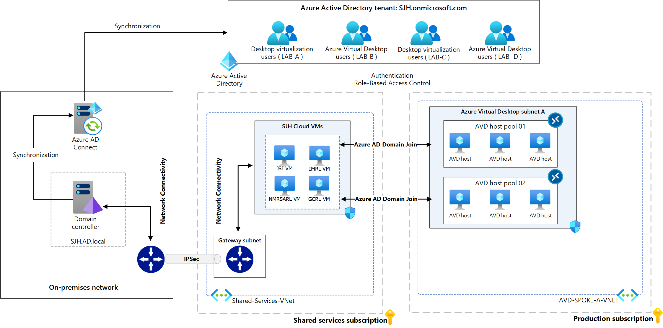
D.1 – Directory & Identity Access Management Services
Access: In line with access requirements, the proposed EY solution is designed to meet access needs now and, in the future, ensuring access to the solution is highly secured, scalable, and stable, while utilising existing access processes and adding detailed auditing and monitoring functionality.
Azure Virtual Desktop (AVD) supports hybrid identities through Azure AD, which will allow the existing users or the new ones to access their application using the same user account.
EY had reviewed SJH User Identities requirements, and we will follow the best practices to comply with the current security base line to handle the log-in details, rotation of user passwords, MFA, managing database level access, and utilise the least-privilege model using Azure role-based access control (RBAC)
Using Azure AD Conditional Access, we will define the Conditional Access framework and policies, and apply different configurations like multi-factor authentication ( MFA), Named locations, Trusted IPs, Internal networks, allowed countries and regions .. Etc.
Fig 1.3– High level design of Access infrastructure for required workloads in Microsoft Azure.

Slide 26
D.1 – Connectivity
Connectivity: In line with connectivity requirements, the proposed EY solution is designed to meet connectivity needs now and in the future, ensuring connectivity for labs and their users into the solution is highly secured, scalable, and stable, while still being based on current connectivity infrastructure on-prem and in the cloud.
Connectivity to the proposed solution will be achieved by utilising an Azure vWAN Hub which consists of an Azure Firewall and Azure Virtual Network Gateway. This will be a highly available connectivity solution and will be failure redundant as connectivity resources will be replicated to all availability zones within the same geographical region (EU North - Ireland). If a multiple regional design is selected, these resources will also be replicated and configured to a replication / DR tenant in (EU West - Netherlands).
By utilising an Azure vWAN Hub, future needs for network communication, increased throughput, bandwidth, stability, and reduced latency can be easily achieved. On-Premises environments will connect to the Azure vWAN Hub via IPSec VPNs in a similar fashion to the way they do now, provided that currently internal networks and IPS lines are capable of meeting the network requirements outlined in the tender document. In the event that they are not, Azure Express Route or Azure Express Route Direct can be utilised to achieve the required network goals. EY will adjust the proposed solution to ensure that no lose of connectivity will be experienced by end users if and when required.
Fig 1.4 – High level design of connectivity for required workloads in Microsoft Azure based on current connectivity infrastructure.

Slide 27
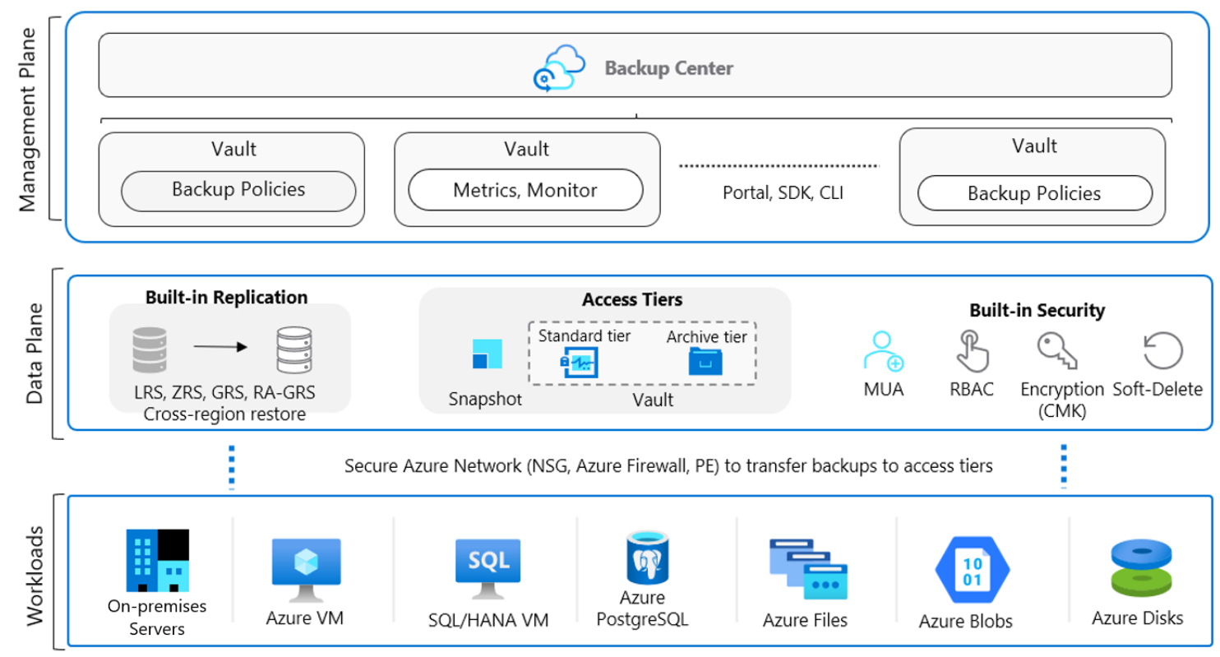
D.1 – Backup
Backup: Azure Backup is a cost-effective and a secure solution which provides independent and isolated backups to guard against accidental destruction of original data.
We are proposing this solution to retain existing SJH Backup & Disaster Recovery architecture, and to comply with existing SJH restoration processes for overall laboratory data.
Using Azure Backup solution, we will be able to back up the Azure VMs whether it's based on ( Windows or Linux ) e.g, JSI Azure VM & NMRSARL Azure VM.
Azure Backup can be extended to support both Azure Files shares and Azure Database for PostgreSQL servers.
For the backup reports and getting more insights on the entire backup estate, Azure Backup provides a reporting solution that uses Azure Monitor and Azure workbooks.
To add an extra layer to the backup availability, Azure Backup supports working with both zone-redundant and geo-redundant storage and can restore backups from a paired region at any time within EU.
To comply with security best practices, EY propose to configure Azure Backup to use role-based access control (RBAC) to grant access to the authorized users for specific backup operations using.
EY will define the Azure Backup policies whether (Standard or Enhanced), and agree on the required retention for the daily, weekly, monthly, and yearly backup points in line with backup requirements.
Fig 1.5 – High level design of full Replication and DR for required workloads in Microsoft Azure.
Image Source: Microsoft

Slide 28
D.1 – Compute
Compute: As per the varied Compute and interconnectivity requirements between them, the proposed solution is design to meet all compute requirements in a security first approach which, does not impact end users. All compute resources will be placed into their own subnets, and access requirements will be heavily controlled and monitored utilising several resources, for example, Azure AD, Azure Conditional Access, Azure MFA, Azure Firewall, Azure NSGs, RBAC, and Security Groups.
Windows based compute resource will utilise the latest version of Windows server. Linux based compute resource will utilise the latest LTS versions of Ubuntu and other distro where required, provided that required Linux software packages are compatible with the newest OS and Kernel versions.
All compute resources will be highly available and split into multiple availability zones where it is required, meaning for example, that two GCRL Linux compute resources “Linux01 and Linux02” will be created. Linux01 will sit in availability zone 1, Linux02 will sit in availability zone 2.
All compute resources will be managed via Endpoint Manager where possible, for example, to apply OS hardening, and other required configurations. Endpoint manager will be used to monitor and report on all device configurations.
All patching of compute resources will be automated where possible, for example Windows compute services will be patched using a patch automation resource, and Linux compute resources will be configured to apply patches automatically via CRON jobs or centralised patching solution where appropriate.
For compute resources facilitating or running critical workloads, a staggered patching approach will be utilised to ensure that these workloads are unaffected if an applied patch causing a workload to fail. Using a staggered approach in conjunction with availability zones ensures that critical compute resources will always be highly available, allowing for fast recovery while, ensuring end user productivity is not affected.
Azure file shares will be mapped to compute resources as network shares over private endpoints. They will also be accessible utilising the “Azure Storage Explorer” application as a secondary access option, in they event that failover/emergency access is required.
Fig 1.6 – High level design of compute infrastructure for required workloads in Microsoft Azure.

Slide 29
D.1 – Data
Data: In line with several data requirements, the proposed EY solution is designed both meet requirements and to facilitate growth of these workloads in a secure and scalable manor, ensuring data is highly secured, scalable, and stable, while still being based on current infrastructure models to ensure there is minimal impact of current productivity processes.
To support the required cloud solutions, three SQL services are required: SQL Server, Azure Database for PostGreSQL, and Azure Database for MySQL.
Microsoft Access will be migrated to SQL Server. PostGreSQL and MySQL will be migrated to Azure’s cloud equivalents. EY also notes the need for a new patient database solution for GCRL, which may require some design thinking on the appropriate underlying technologies to line up to the type of testing performed by the lab (e.g., document-type database vs SQL)
Redundancy will be facilitated via the use of regional availability zones.
Data transfer will be facilitated vis IPSec VPN connectivity, utilising private endpoints to ensure data is not transferred over the public web, to secured databases and Azure storage locations.
Access and authentication to Databases will be serviced via Azure AD in conjunction with Security Groups, Azure RBAC “Role Based Access Control”, and JIT “Just In Time” access where possible.
Azure File Shares & Azure storage accounts will be provisioned as required and secured in line with best practices.
Hot and Cold Azure storage locations will be utilised for the storage of archive data which is not in use and live flat file data in active use. Soft delete, purge protection, and other data protection features in conjunction with Security Groups, Azure RBAC “Role Based Access Control”, will be in place to ensure data is protected to the standards expected.
Microsoft provide several migration capabilities to assist database migrations from on-prem solutions to different Azure services. Example flows below:
Access to SQL Server
Create new SQL Server Migration Assistant (SSMA) project
Add access database files to the project
Connect to target instance of SQL Server
Customise source-target mapping if needed
Create assessment report on predicted success/failure of load
Convert Access database objects to SQL Server definitions
Load converted database objects into SQL Server
Migrate Access data to SQL Server
MySQL Migration
Backup database
Configure Source and Target instance parameters
Export database objects
Export the data
Import database objects
Import data
Validate successful imports
Migrate application(s) if required
PostGreSQL Migration
Create Azure Database Migration Service Instance
Create
Export database objects
Export the data
Import database objects
Import data
Validate successful imports
Migrate application(s) if required

Slide 30

D.1 – Deployment Management
Deployment Management: The proposed solution will be deployed utilising DevOps CI/CD pipelines. This ensures consistency in infrastructure configuration and standards across the solution, allows for fast testing and deployment of infrastructure changes in incremental “bite size” steps, which minimises environment impacts and impacts to end users.
Infrastructure deployments will be orchestrated via DevOps frameworks and processes, utilising tools such as Azure DevOps, GIT, and Terraform to create standardised reusable Infrastructure as Code frameworks which are deployed via CI/CD pipelines to Azure subscriptions and resource groups. This enables incremental changes and updates to be developed, tested, and implemented in real time, minimising impacts to critical services, and reducing the need for service downtime.
The proposed solution will utilise Azure Policies to manage access, policies, and compliance for subscriptions and resources, by arranging management groups in a single hierarchy that aligns with management requirements outlined in the tender documentation.
Fig 1.7 – High level design of DevOps processes used to develop, test, and deploy Infrastructure as Code for required workloads in Microsoft Azure.

Slide 31
D.1 – Network
Network: As there are several networking requirements outlined, the proposed solution is designed to meet networking needs now and in the future. The design allows for fast, secure, and scalable increase in networking requirements, via a highly available and resilient design, enabling a truly flexible and secure hybrid network.
As subscriptions will be utilised to group resources by environment owner, Saint James Hospital and each lab will have all resources related to their requirements held in their own subscription. This creates a natural layer of separation between them and facilitates a more controlled, and robust networking framework to be successfully implemented.
Networks will be highly segregated and controlled via the Azure Firewall and Network Security Groups (NSGs), which, will be used to shape traffic to and from On-Prem environments and between Azure environment vNets. In the event that labs require networking interconnectivity to each other, this can be achieved via the proposed solutions Azure vWAN Hub.
Utilising this networking framework and methodology facilitates several benefits, for example:
Network management, monitoring, and security improvements.
The proposed solutions networking capabilities are future ready, meaning the network can quickly scale to meet future need in a modular manor.
Fig 1.8 – High level design of networking infrastructure for required workloads in Microsoft Azure.

Slide 32
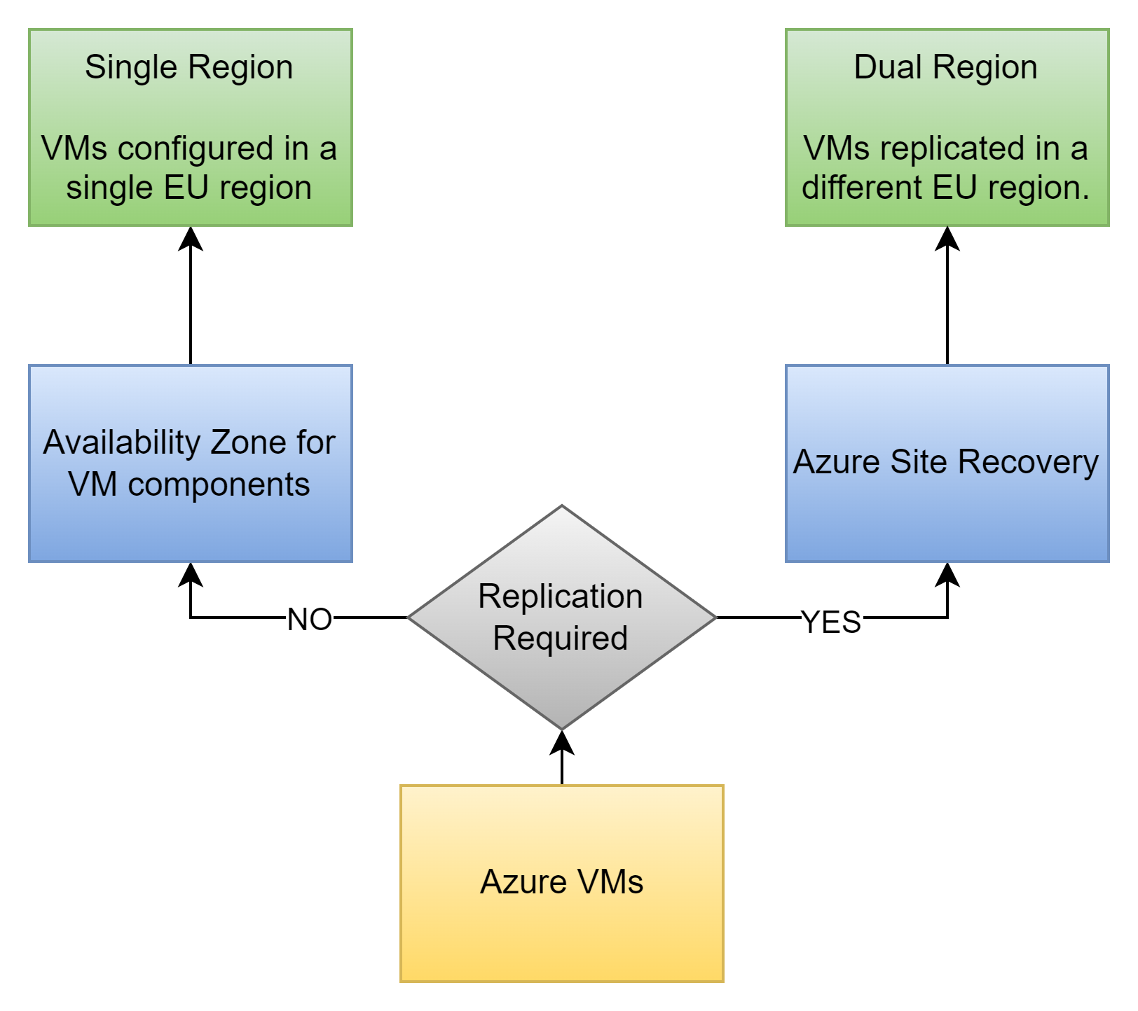
D.1 – Recovery
Recovery: With this Enterprise DR strategy, the proposed solution will increase uptime for all Azure resources and data, ensuring they are available even during disaster conditions. This aligns with the requirement for a disaster recovery architecture with an alternate regional location within the EU. The Azure site recovery provides a robust solution with real-time replication of the resources.
As part of the Disaster recovery solution, either one, or a combination of the following two approaches could be used:
Azure Site Recovery (Regional Resiliency)
Azure Site Recovery is a disaster recovery solution that replicates workloads running on VMs from a primary site to a secondary location in a different region. When an outage occurs at the primary site, a fail over to a secondary location can be performed, and the VMs can be accessed from there.
Site Recovery uses real-time continuous replication and recovery automation to replicate workloads across regions. The built-in platform capabilities for VM workloads meet SJH’s low RPO and RTO requirements.
It fulfils the requirements of recovering both Windows and Linux VMs which will be used across different labs.
It gives the option of automatically creating the following target resources at the time of DR: VM, Resource Group, VNet, Managed Disks, Availability Zones.
Availability Zone (Zonal Resiliency)
If replication is not an option, we can make use of the Availability Zones for VM components which are Zone Redundant, like Storage Disks, VNet, Firewall, etc.
An Availability Zone is a physically separate zone, within an Azure region. It will enable the VM components with Zonal resiliency.
There are three Availability Zones per supported Azure region. If one zone is compromised, then replicated config and data are instantly available in another zone.
Fig 1.9 – Example of simple recovery flow to recover data and resource workloads in Microsoft Azure.

Slide 33
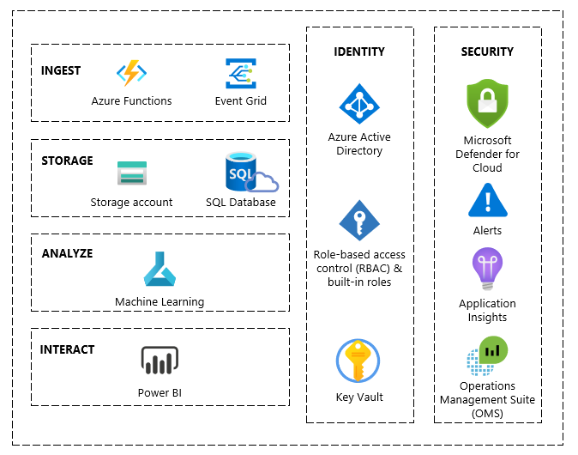
D.1 – Security
Security: The proposed solution delves into the critical role of security, exploring its application in the proposed solution, to safeguard sensitive information, maintain business continuity, and foster a secure and trustworthy hybrid environment. By integrating comprehensive security practices, the proposed solution confidently embraces the advantages of the cloud, while mitigating potential risks and vulnerabilities.
EY leverages the Microsoft Zero Trust (ZT) approach to secure Azure implementation comprehensively. By incorporating security by design and privacy by design principles, this ensures that identities, endpoints, applications, data, infrastructure, and networks are safeguarded while respecting confidentiality, integrity and availability.
Identity and Access Management (IDAM) – Starting with identities, EY will configure multi-factor authentication, conditional access, Privilege Access Management (PAM), Role Based Access Control (RBAC) and Azure AD Identity Protection to verify users identities and control access to resources. This is to ensure secure adaptive access, Just in time and Just enough access.
Securing Endpoints – EY will leverage the Virtual Desktop Infrastructure (VDI) policies to harden the access layer on the environment to align with the CIS benchmarks. This will enforce device compliance policies, regular updates, and encryption measures to protect the sensitive data while ensuring privacy by design, with limited data collection and strong encryption protocols.
Securing Applications - Applications are thoroughly protected through Azure AD Application Proxy and Conditional Access, enabling EY to implement strict access controls based on user identity, location, and device posture. Simultaneously, privacy by design is maintained by integrating user consent mechanisms and performing regular audits to assess and mitigate data privacy risks.
Data Security - Data security remains paramount, with EY using Microsoft Purview to classify and label sensitive data, implement DLP policies, and employ data encryption at rest and in transit to ensure compliance with GDPR regulations.
Network and Infrastructure Security - EY adopts Virtual Network (VNET) segregation, Network Security Groups (NSGs), and Azure Firewall to control and monitor network traffic, preventing threats from propagating within the infrastructure. By enabling Microsoft Defender for Cloud this will strengthen the cloud security posture, defend against evolving threats, control access to critical resources and help to secure every step of the DevOps lifecycle.
Fig 2.0 – Example to Azure services used to security proposed solution resources and workloads in Microsoft Azure.

Slide 34

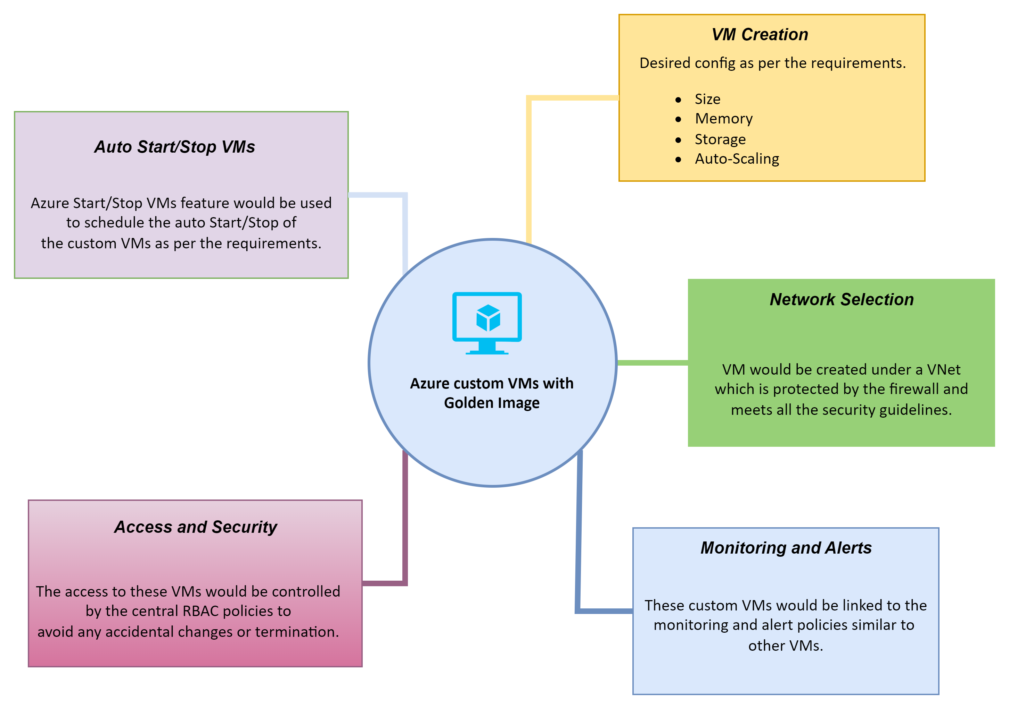
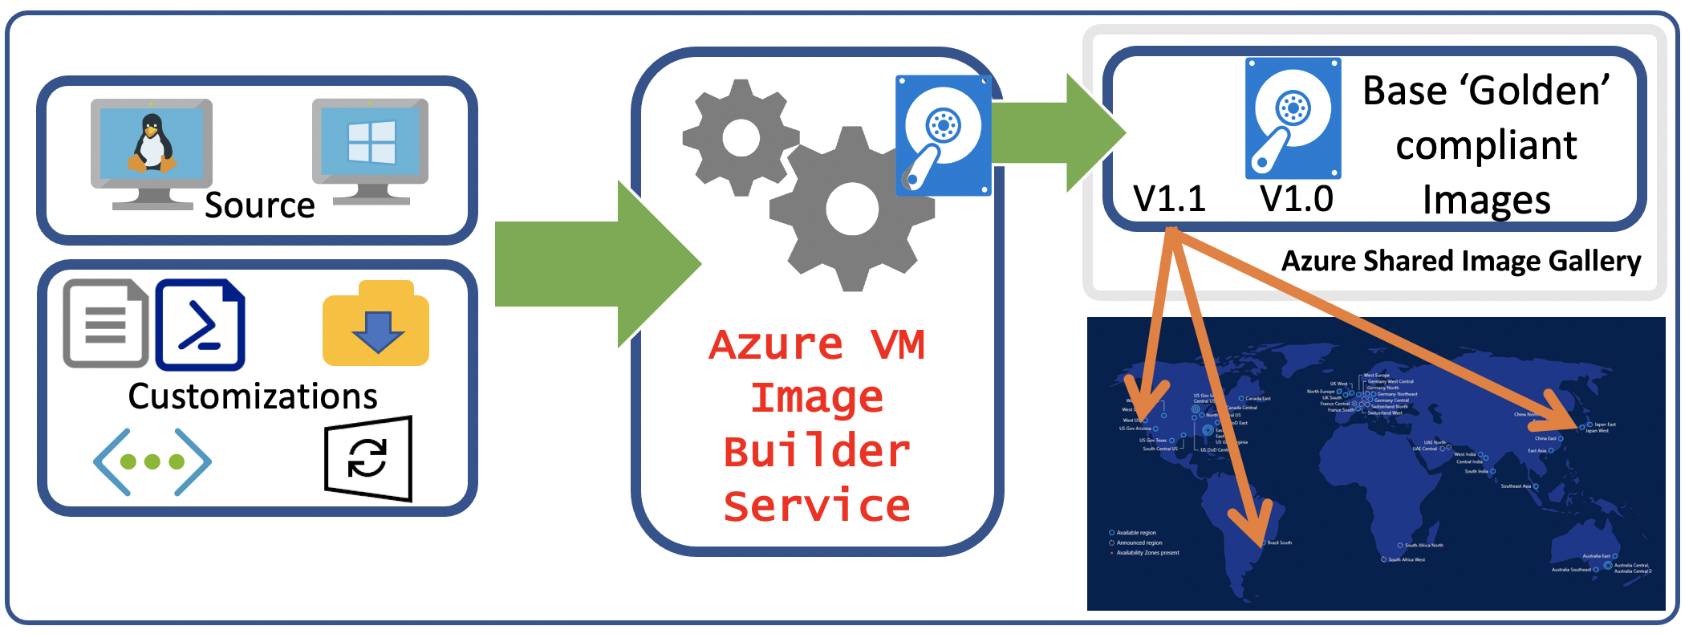
D.1 – Golden Image
Golden Image: VM Image Builder is a fully managed Azure service that allows to create customized Virtual Machine Images. It can be used to automate and simplify the Image building process. It supports using Windows, Linux or custom images and the addition of custom scripts, command and applications on top of it. It allows to build multiple images which would be suitable for SJH's various use-cases.
The Azure VM Image builder provides the below features to facilitate SMJ's requirements for custom VM:
Using the golden image, provides stability to the VM by avoiding any OS level glitches.
It can make use of the existing networks to provide security along with the access to the whitelisted domains.
The VMs can be scheduled to start and stop automatically resulting in up-time savings.
Since the access to creation, stoppage and usage of the VMs would be controlled by the RBAC, it keeps the VMs safe from unwanted access and unauthorised changes.
The VMs would also be synced with the Azure monitoring policies to keep the checks in place. This will also result in generating the alerts for the configured events.
Fig 2.1 – High-level workflow of Azure VM Image Builder
Fig 2.2 – Example depicting the features available through Custom VMs

Slide 35
E.
Detailed Delivery Approach
E.1 – Our Detailed Delivery Approach
E.2 – Training & Knowledge Transfer

Slide 36
E.1 – Our Detailed Delivery Approach

Slide 37
Delivery Structure
The following is an example of a delivery structure which can be utilised to successfully deliver the proposed solution as outlined in Section D.
Project Board
3rd Parties
Service Quality Review
Strategic Governance
Quality Assurance Partner
Engagement Partner
SJH Project Sponsor
Platform Vendor
Microsoft
Paul Browne
Partner - Technology Consulting
Brian Moroney
Partner - Technology Consulting
Delivery, Performance, KPIs
Service Management
EY Quality Assurance Group
Project Manager
Brian Bambrick
Senior Manager - Technology Consulting
SJH Engagement Manager
Software Providers
Microsoft
Open Source Vendor
Resourcing and Operations
Delivery
EY Global Subject Matter Resource (SMR) Panel
Technical Lead
Mathijs Lautenbach
Director - Technology Consulting
SJH Technical Resources
Vendor
Technical Resources
Applications
Lab Equipment
Cloud Architect
Cloud Engineer
EY
Test Manager
SJH
3rd Parties
Fig 2.1 – High level example of project delivery structure.

Slide 38
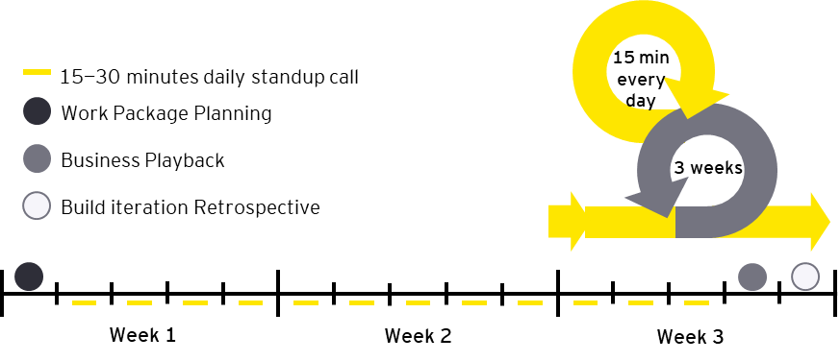
Build Methodology
WRICEF development & functional configuration is delivered during the ‘Realise – Build’ phase of EY’s delivery methodology. Our methodology takes an agile approach to build to improve business engagement, knowledge transfer and reduce the risk of rework. Build is broken into time-boxed iterations (known as ‘Build Iterations’) with configuration and development scope bundled into functional work packages. A key aspect of this approach being the regular, more frequent interactions with the business stakeholders based on manageable chunks of build. 3-week Build Iteration cycles are sequenced according to the project critical path, and typically fall into one of 5 priority buckets. The first three priority buckets are required
for the first Integration Testing cycle.
We anticipate a relatively low amount of effort will be required for enhancements
Enhancements critical for End-to-End processes
Other enhancements
Interfaces and workflows
Reports
Forms
Build iterations are composed of four key activities:
Work Package Planning: Meeting conducted to define the scope that will be included in build iteration. At the end of the meeting, there is a clearly defined build iteration work package. Additional backlog items may be added during the build iteration if progress is ahead of plan
Build Iteration Execution: During the build iteration the solution is defined according to the work package scope and daily stand-up meetings are held to track progress.
Business Playback: Meeting at the end of the build iteration for the End-to End Process team to playback the developed functionality to the Business Process Owner. The BPO will approve/reject the build.
Build Iteration Retrospective: Meeting after the business playback to discuss lessons learned in preparation for the next build iteration.

Slide 39
EY’s Delivery Methodology
EY’s Delivery methodology is an agile approach to development
Prepare
Explore
Realise: Build
Realise: Test
Deploy
Run
Confirm purpose, vision and scope for the transformation. Kickstart solution design with industry templates and accelerators.
Perform fit-gap to leading practices and design delta solution for gaps, documenting requirements in a prioritised backlog of user stories.
Build and unit test solution in time-boxed iterations based on prioritised backlog, load master data.
Perform integrated testing of solution and train end users.
Cutover to production and deploy new solution.
Support new solution through hypercare and handover to service management.
EY’s Delivery Methodology
During Prepare phase we will establish the PMO & governance processes.
We will gather artifacts relating to processes, and business requirements in preparation for design workshops.
Initial configuration of org. structure elements can also commence to support workshop demo capability.
The goal of the Explore phase is to produce an overall solution design, based on agreed design principles, that is tested from a technical, functional and business perspective. EY’s 2-stage workshop approach together with the Design Authority governance layer forms a robust process to deliver a fit-for-purpose design.
We will deploy a prioritised sprint approach using 3 week 'Build Iterations' to deliver a unit-tested solution against the agreed solution. Working closely in cross-functional teams is a critical success factor at this stage, together with regular playbacks to stakeholders to support a high-quality outcome.
Multiple forms of testing will be executed during this stage to give assurance that the solution functions correctly, is performant, meets the business requirements and that security roles are correctly mapped. Train-the-Trainer workshops will also be carried out during the Test phase in preparation for cut over.
Once the testing stage gates are passed with defects adequately resolved, cutover to the production system can commence based on a carefully planned and rehearsed sequence of steps. Regular control checkpoints and Go/No-go reviews will be carried out. End users will receive training during this phase.
EY will provide hypercare support for the 2 weeks following go-live and will also execute detailed knowledge transfer plan with its own series of checkpoints to ensure a smooth & successful transfer to support and managed services teams.

Slide 40

Proposed Project Timeline
2023
Project Phases
M1
M2
M3
M4
M5
M6
M7
M8
PREPARE Define Project charter, Project processes, an overall plan, and project org structure. Assign resources and agree on project tooling. Gather inputs for Explore phase including clearly defined requirements.
PREPARE
Onboarding & access
Program management start-up
Requirements gathering
Ongoing Project Management
EXPLORE Workshops are conducted to map business processes and identify & resolve gaps. A plan for data cleansing is developed and cleansing activities are initiated. Configuration design and functional specifications are documented.
EXPLORE (Design)
Requirements review
High-level design creation
Low-level design creation
Infrastructure deployment plan
REALISE – BUILD Platform configuration, Infrastructure implementation, System configuration and data migration are performed. Unit testing is performed on provisioning lab environments.
REALISE - BUILD
Infrastructure implementation
Infrastructure testing & QA
Systems Configuration
Data Migration & Validation
Build Iterations: 2 week sprints based on prioritised backlog
REALISE – TEST UAT testing performed based on lab requirements with mock data and Go-No criteria are agreed with first assessment following UAT. Solution documentation is availed on UAT completion.
REALISE - TEST
UAT Planning
UAT
Bug fixing
Solution Documentation Completion
DEPLOY & RUN Cut over is commenced and a further Go/No Go assessment is made 2 weeks out from Go Live. End users are trained by Super Users (trained by EY during Test phase). Hypercare support to run for 2 weeks post Go Live.
DEPLOY & RUN
Documentation shared
Define support levels/SLAs
Support team training
End user training

Slide 41
Prepare
Confirm purpose, vision and scope for the transformation. Kickstart solution design with industry templates and accelerators.
Prepare is the first phase of the implementation and aims to provide the initial planning and preparation for the project.
A series of scoping workshops are held to confirm the purpose, vision and scope, utilising industry templates and accelerators. The outputs of these workshops are scoping documents which also serve as an input to solution architecture development.
In parallel, preparation is done for future phases of the project by defining a number of implementation strategies and preparing for data migration and platform management.
Key Activities*
Form Program (if not done in Discover)
For each workstream
Develop Business Case (if not done in Discover)
Setup Infrastructure and Tooling
Conduct Solution Scoping
Develop Solution Architecture, Develop Implementation Strategies
Prepare for Data Migration
Complete Technology Planning
Setup Sandbox Environment and Activate Solution
Setup Development Environment and Activate Solution
Prepare for Test Management
Change Experience for Prepare
Close Phase
Key Deliverables*
Project management plan
Project schedule
Scoping document
Business Process Master List (BPML)
Solution architecture document
Implementation strategies¹
Data quality assessment
Technical operations plan
EY Industry Solution Development environment
Project quality gate review
Change Experience Deliverables for Prepare
*These lists are indicative and will be updated at a later stage
EY Differentiators
Industry-based Business Process Master List (BPML) incorporating leading processes, KPIs, risks, controls and automation opportunities and mapped to Power Platform Best Practices
Business-led scoping workshops based on end-to-end business scenario

Slide 42
Explore
Perform fit-gap to leading practices and design delta solution for gaps, documenting requirements in a prioritised backlog of user stories.
The purpose of Explore is to confirm whether business requirements can be satisfied and define whether they can be met through standard Power Platform functionality or custom developments.
This is done via two cycles of workshops — ‘Workshop A’ aims to perform a fit-gap against what is available as standard (leveraging EY Industry Solution) and ‘Workshop B’ aims to confirm the design for the delta gaps which cannot be met by standard. All requirements are captured as user stories in a backlog which is prioritised and groomed in preparation for Realise — Build.
Key Activities
Manage Each Workstream
Train Program Team
Explore Benefits
Create Initial Solution Backlog
Conduct Fit to Standard Design, Delta Design, Detailed Design
Update Solution Backlog, Solution Architecture
Develop Analytics and Information Management Plan, Data Cleansing and Migration Plan, Test Plan
Setup Test Environment and Activate Solution
Setup Quality Environment and Activate Solution
Develop Technical Solution Design, Security and Controls Plan, Centres of Excellence
Conduct Release Planning
Establish Service Management
Change Experience for Explore
Close Phase
Key Deliverables*
Benefits value dashboard
Prioritised solution backlog
Business Process Documents¹
Technology catalogs²
Functional specifications
Enterprise role matrix
Data governance plan
Data cleansing and migration plan
Analytics and IM plan
Test plan
Test and QA environments
Technical solution design
Security and controls plan
Project quality gate review
Change Experience Deliverables for Explore
*The list of Deliverables are indicative and will be updated at a later stage
EY Differentiators
Industry-based Business Process Master List (BPML) incorporating leading processes, KPIs, risks, controls and automation opportunities and mapped to Power Platform Best Practices
Business-led design workshops based on end-to-end business scenario

Slide 43
Realise — Build
Build and unit test solution in time-boxed sprints based on prioritised backlog and load master data.
The purpose of Realise — Build is to take the output of explore (a prioritised solution backlog) and build the solution in a number of time-boxed iterations (called sprints). Unit testing and documentation is also done within these sprints.
Each sprint lasts 2-4 weeks and follows the same pattern: Sprint Planning —Sprint Execution — Business Playback — Sprint Retrospective.
Environment after environment, resources are provisioned across all laboratories and basic validations are attempted through Unit testing.
Master data is loaded on confirmation in preparation for user acceptance testing performed in the next phase.
Key Activities
Deliver the Program
Manage Each Workstream
Realise Benefits
Develop RICEFWF Technical Specifications
Execute Sprint zero Baseline Build
Deliver Build Sprints
Develop Long Lead Time/Enabler RICEFW Objects
Perform Data Cleansing
Build Analytics and Reporting Solution
Prepare for Data Migration
Build Security and Controls
Prepare for Testing
Update Technical Solution Design
Set up Staging/Training Environment and Activate Solution
Build Technical Solution
Develop Service Management Plan
Develop Cutover and Deployment Plan
Change Experience for Realise Build
Close Phase
Key Deliverables*
Benefits realisation plan
Sprint zero baseline build
Solution build (including RICEFWFs)
Technical specifications
Test plans¹
Training environment
Service Management Plan
Cutover and Deployment Plan
Project quality gate review
Change Experience Deliverables for Realise (Build)
*The list of Deliverables are indicative and will be updated at a later stage
EY Differentiators
Embedded data and change management within functional scrum teams to minimise risk associated with data migration and drive better business adoption of solution
Technical IP (rapid cloud infrastructure) to accelerate build of technical solution

Slide 44
Realise — Test
Perform integrated testing of solution and train end users.
Realise — Test is the second part of the Realise phase in Activate and has been separated into its own phase to provide the necessary focus and rigor on user acceptance testing (UAT).
In this phase, test cycles are performed, training is provided via a train-the-trainer approach and preparation takes place for cutover and deployment.
These test phases are not undertaken in sprints. On each lab environment coming available, UAT plans are carried out on the platform to validate and affirm its operational effectiveness.
Key Activities
Deliver the Program
Manage Each Workstream
Track and Monitor Benefits Realisation
Conduct System Integration Testing, System and Performance Testing, Regression Testing, User Acceptance Testing, Security Roles and Controls Testing, Cybersecurity Testing, Data Migration Mock Runs
Perform Final Data Cleansing
Validate Migration Data
Set up Production Environment
Set up Failover Infrastructure
Test Technical Infrastructure
Prepare for Service Management
Update Cutover and Deployment Plan
Prepare for the Cutover, Deployment, Hypercare
Change Experience for Realise Test
Close Phase
Key Deliverables*
Test results sign-off¹
Final data cleansing report
Production environment
Failover infrastructure
Rollback plan
Contingency plan
Hypercare support plan
Project quality gate review
Change Experience Deliverables for Realise
*The list of Deliverables are indicative and will be updated at a later stage
EY Differentiators
EY’s approach in separating out Realise — Test as a separate phase and not mandating it be completed in sprints ensures that there is enough focus and rigor on systems integration testing without any competing demands from Build
Automated testing can be performed if desired

Slide 45
Deploy
Cutover to production and deploy new solution.
The purpose of the Deploy phase is to cutover from project environments to the live Production environment and deploy the solution to end users.
Although the actual cutover usually takes place on a weekend, the Deploy phase is a longer period of time and includes both pre- and post-Go-Live activities.
In addition to solution deployment, final end user training occurs and preparation for hypercare and transition to service management is performed.
Key Activities
Deliver the Program
Manage Each Workstream
Prepare the Business for Go-Live
Prepare Technical Infrastructure for Go-Live
Provision Production Access
Finalise Cutover and Deployment Preparations
Confirm Cutover and Deployment Readiness
Prepare for Hypercare
Cutover to Production
Prepare for Service Management
Change Experience for Deploy
Close Phase
Key Deliverables*
Cutover runbook
Technical system test results sign-off
Go/no-go report
Promote to Production checklist
Production data load sign-off
Change Experience Deliverables for Deploy
*The list of Deliverables are indicative and will be updated at a later stage

Slide 46
Run
Support new solution through hypercare and handover to service management.
The purpose of the Run phase is to provide hypercare support to the newly-deployed solution.
After Hypercare is exited, the solution transitions to service management and assessments are done to further optimise and automate the solution.
Key Activities
Close the Program
Optimise Benefits Realisation
Conduct Post Go-Live Training
Provide Hypercare Support for Solution
Provide Hypercare for Technical Infrastructure
Transition to Service Management
Assess and Optimise Service Management
Change Experience for Run
Key Deliverables*
Value audit strategy
Benchmarking strategy
Project closure report
Post-implementation review
Service management assessment
Project quality gate review
Change Experience Deliverables for Run
*The list of Deliverables are indicative and will be updated at a later stage
EY Differentiators
EY delivery method which provides a framework for measuring and implementing ongoing optimisation across the organisation
EY Benchmark platform with industry-tailored metrics and KPIs for organisations to be assessed against
EY’s Change Experience which focuses on business adoption and optimisation through lenses such as behavioural change and capability development

Slide 47
F.
Pricing
F.1 – EY Services & Costs

Slide 48
F.1 – Pricing proposal
EY Service Costs
EY will deliver immediate value to the Department through a highly competitive offer, which we commit to on a Time & Materials basis. Following the Explore phase, we will carry out a joint review of the effort required to deliver the design, with the view to making a further reduction in our price should the effort come in lower than our baseline estimate.
Additionally, we commit to review the Managed Service costs every 6 months with the view of reducing the cost to the Department based on the experienced volume
* We have applied a 13% discount across the full implementation engagement as our investment. ** Only relevant where A/M/C activity is estimated to be >40 hrs effort. Below this threshold all AMC activity is included in Base Service Cost. *** Included in Base Service Cost, without caps or limits for L1, L2, L3 requests per month. **** Per clarification questions, EY assume the Department will procure licenses directly from Microsoft, i.e., via an existing Enterprise Agreement via SoftwareOne .
Price component (ex VAT) | Year 1 | Year 2 | Year 3 | Total
Digital Customer Contact Centre Implementation* | €1,674,063.00 | €0 | €0 | €1,674,063.00
Managed Services | €0 | €162,000.00 | €162,000.00 | €324,000.00
Additional Costs for Adds/Moves/Changes** | €0 | €16,500 | €16,500 | €0
Additional Costs for Incident Response*** | €0 | €0 | €0 | €0
Total price | €1,674,063.00 | €162,000.00 | €162,000.00 | €1,998,063.00
Price component (ex VAT) | Year 1 | Year 2 | Year 3 | Total
Digital Customer Contact Centre licenses | €11,844.62 | €71,067.72 | €71,067.72 | €153,980.06
Customer Online Portal System licenses | €24,713.76 | €148,282.56 | €148,282.56 | €321,278.88
Cybersecurity Protections | €1,240.00 | €7,440.00 | €7,440.00 | €16,120.00
Ancillary Azure Services | €19,689.66 | €6,357.96 | €6,357.96 | €32,405.58
ID-pal Liveness Check & Facial Comparison | €2,000.00 | €188,000.00 | €188,000.00 | €378,000.00
Total price**** | €57,488.04 | €421,148.24 | €421,148.24 | €899,784.52

Slide 49
F.
Contract Management & Quality Assurance
F.1 – Governance
F.2 – Quality Assurance Process
F.3 – Training & Knowledge Transfer

Slide 50
F.1 – Governance

Slide 51
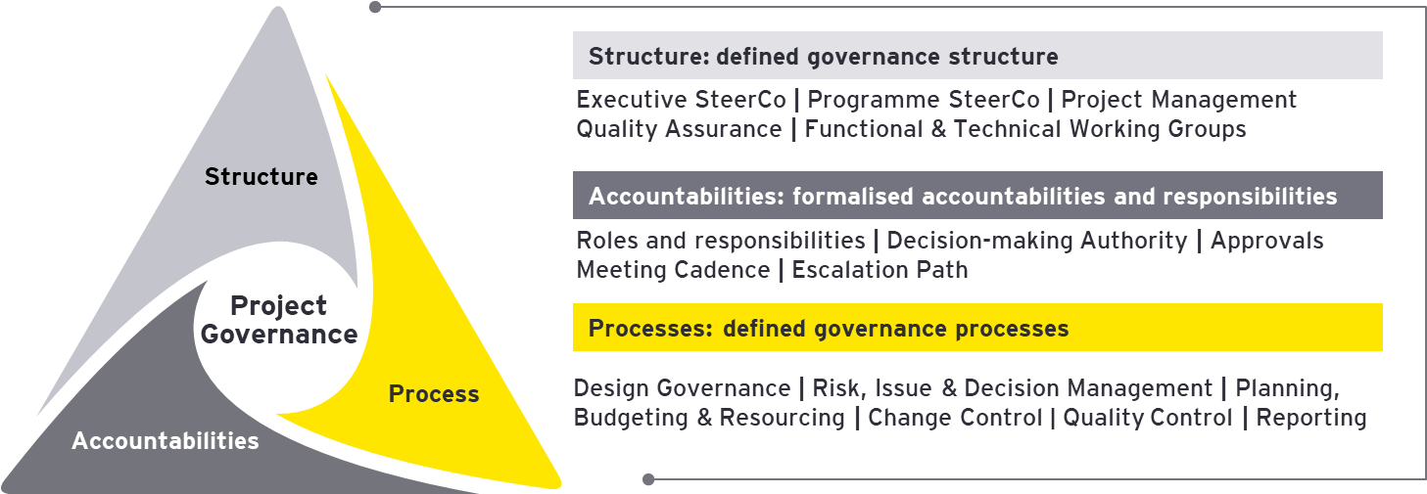
EY’s Governance Framework
An effective governance model defines the structures, the accountabilities and the processes necessary to make timely decisions that stick and that involve the appropriate set of stakeholders and decision-makers.
Success will hinge on the effectiveness of the defined governance structures and rigorous programme management. One of the key roles of Project Management in EY’s delivery methodology is to ensure these three elements of governance (structure, process, accountability) are established from the outset and are continuously monitored for adherence to the principles defined in the project charter & playbook and remain effective throughout. Our Project Management method is based on the Project Management Institute (PMI) Project Management Body of Knowledge (PMBK), and includes detailed activities and deliverables across 5 key stages.

Slide 52
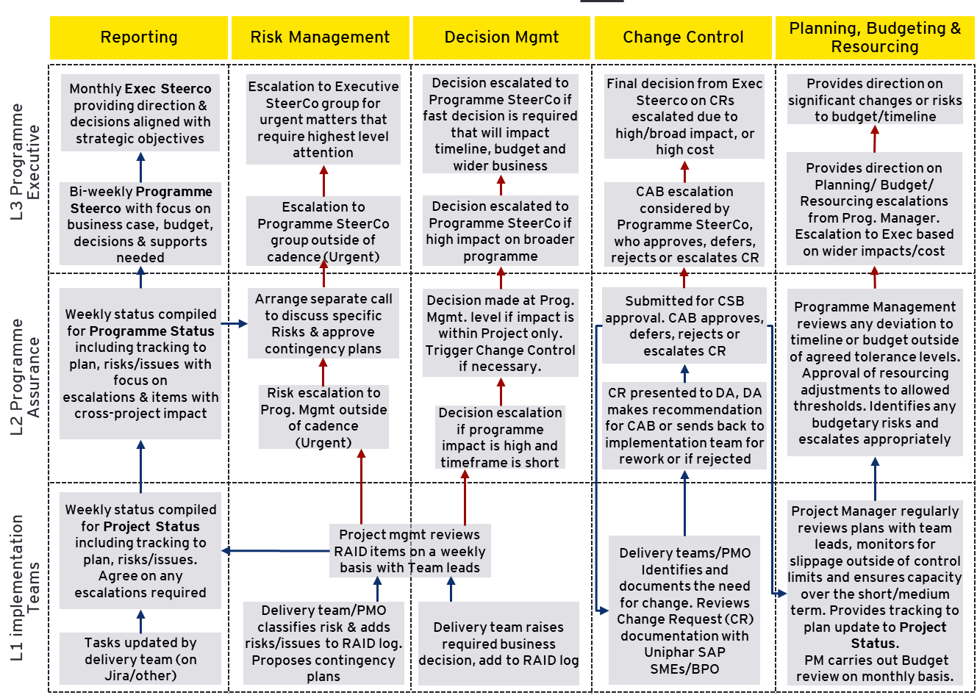
EY Governance Processes
Our governance methodology is based on 6 key processes managed by the PMO that together maximise efficiency and the ability to react to situations, as well as minimise scope, timeline and resourcing risks:
Project Reporting
Risk management
Decision management
Change Control
Planning, budget tracking and resourcing
Quality control
Input
Escalation

Slide 53
F.2 – Quality Assurance

Slide 54
EY RACI Example
For each step / milestone / work product in the project (see example below), EY will agree with all stakeholder stakeholders who will be assigned RACI roles (explained below).
R
A
C
I
Who is responsible for the execution of the task?
Who is assigned to work on the task?
Who is accountable for the tasks and signs off the work?
Who has the authority to make decisions?
Who are the subject matter experts who are to be consulted?
Who can help on the tasks?
Who are the stakeholders who need to be updated of the progress?
Are there stakeholders whose work depends on this task?
Activities | Project sponsor | Project manager | Project team | Stakeholder groups | Steering committee | Change control | Engagement Partner
Phase 1 - Initiate
Develop project charter
Identify stakeholders
Phase 2 – Plan
Plan scope
Plan schedule
Plan cost
Plan quality management
Plan supplier management
Plan stakeholder management
Establish project baseline
Develop project management plan
Phase 3 – Execute
Establish project procedures and standards
Direct and manage project work
Perform quality assurance
Develop project team
Manage project team
Report status
Manage communications
Obtain project feedback from sponsor
Obtain suppliers
Sample Project RACI

Slide 55
EY Quality Assurance
Three-tier bottom-up approach to product and service quality assurance
Level 1: Delivery Processes
1
Level 3: Service Quality Review
Functional specification quality review
Regular solution playbacks
Code quality reviews
Rigorous testing and defect resolution
Performance testing
User acceptance testing
Led by the EY Service Quality Partner
Initial Expectations of Service Quality (ESQ) session to level-set on what exceptional client service means
Regular Assessments of Service Quality (ASQs) reviews to assess progress versus expectations, e.g.:
Check if project milestones been met, and in a satisfactory manner
Provide early warning signals for any potential corrective action required
Record feedback and scoring, track and seek to improve on KPIs as programme progresses
2
Level 2: Governance Processes
Design governance: Fit-to-Standard and Design Principles validated by Design Authority
Risk, Issue & Decision Management
Stage Gate reviews per phase
Resource quality reviews
3

Slide 56
Quality Assurance, Program Monitoring & Change Control
Programme deliverables quality and Service Quality
Quality Management Plan: This plan outlines the procedures that all programme individuals need to follow in order to produce and gain approval for a programme deliverable. It also contains quality guidelines for the types of documents and designs being produced and detailed RACI of who needs to review and approve each deliverable. This provides clarity on deliverable standards that need to be complied with when producing deliverables. All deliverables and outputs from each stage will be stored within the Quality Management System we will create for SJH.
Deliverable Health Check Report: This is an independent review conducted by PMO on all deliverables produced by the EY team to ensure they comply with the quality plan for the programme. It serves as an early warning of any gaps in key deliverables and artefacts.
Quality Stage Gate Reviews & Tracker: We will use Quality Stage-gates towards the end of every phase or stage of the programme to check that the programme has achieved what it set out to do and it is of the requisite quality level. This tracker ensures that any of the outcomes of the reviews are accurately tracked and managed.
EY will perform two key quality management activities:
Expectations of Service Quality (ESQ): At the start of the Prepare phase, an Expectations of Service Quality (ESQ) review will be undertaken with all stakeholders and EY leadership to gain a full view of expectations and targets around service quality. This common agreement, with defined KPIs and targets, is then used throughout the service to measure quality and performance.
Assessments of Service Quality (ASQs): At specified intervals (typically every quarter), we propose that an ASQ is performed with stakeholder leadership and the EY Delivery Lead, Engagement Partner or an independent EY Quality Assurance Partner to assess the service quality being provided on the engagement
Program monitoring and Change Control
A rigorous governance process around Change Requests (CRs) will apply during the programme:
CRs will need to provide a business case, clearly articulating the business value and RoI. Only CRs that can demonstrate business value and an agreed RoI will be approved.
Approved CRs will be bundled, categorised and presented at Programme Steering Committee each month with appropriate levels of detail, including any additional cost resulting from the CRs.
In addition, a proposed list of five effective KPIs to effectively monitor and manage the program are proposed:
Schedule Variance
Schedule Performance Index (SPI)
Cost Variance
Cost Performance Index (CPI)
Planned Versus Actual Resource Utilisation

Slide 57
J.1 - Quality Management System (QMS)
The Quality Management System we will operate will adhere to ISO 9001 (EC, HPRA, MHRA, EMA, MRA and similar) Quality Management Principles and Regulations, and be compatible to ISO 15189:2012 and 15189:2022, especially within our approach to acceptance testing, explained within the Detailed Delivery Approach section. The QMS and the ISO Certs above are central to the processes we will follow and the tasks we complete.
Holistic approach and strong foundation to unlock insights:
The future of integrated and seamless Quality Systems is a digitally enabled and empowered workforce. A future-focused design of D&A strategy will help the Cloud Storage Implementation focus on both people and technology.
This approach will enable connectivity, higher data quality, advanced analytics, automation, steady state governance and great user experience.
It will also include extensive collaboration with SJH during audits (IDAM, DR/BC and any other), penetration testing, user acceptance testing, and approvals for training plans and documentation used and any scenario where we will need SJH involvement. It is critical to ensure we maintain the quality of the system and therefore the quality of the overall QMS, and this collaboration is key at every stage.
EY will facilitate an independent security review (penetration testing), by a specialist company contracted by SJH and will collaborate accordingly with them. Also we will work with this company and any other third party company in the swift resolution of any security issues identified.
Training record Management
Audits and Inspection Management
Document Management
Risk management
ISO 9001 ISO 15189
Asset
(Equipment)
Management
Quality Systems
IT system Management
Reskilled Workforce
3
Performance culture
Better outcomes creates value
2
Engaging and empowering of people
Action
1
Standard ways of working
Decision
Customer Management
SDLC ,CSV
CAPA, Incident,
Change control, Deviation,
Complaint Management
Well designed QMS platform
3
Data given decisions
Insight
Problem centric application of technology
2
Data
Instrumented, integrated and contextualized data
1

Slide 58
J.1 - Quality Management System (QMS)
A Quality Assurance program is based on the application of validated and detailed quality assurance, reliability, test and customer service plans. Below describes some of the main QA program initiatives EY will follow and adhere to during the engagement with SJH.
Quality Management Process as explained within the Detailed Delivery Approach section, is a set of procedures that are followed to ensure that the deliverables and services produced by the team are "fit for purpose".
EY will ensure that by following the Quality Management Process, quality issues are identified promptly and resolved quickly.
Quality Objectives
The main quality objectives of EY are to:
Deliver services and solutions that meet SJH’s requirements.
Continually enhance SJH’s satisfaction by reducing non-conformity, timely deliverables, effective sub-contractor/supplier management.
Improve productivity and reduce rework.
Quality Management
EY team will:
Determine the processes needed for the Quality Management System and their application throughout the execution of the project.
Determine the sequence and interaction of these processes.
Determine criteria and methods needed to ensure that both the operation and control of the processes are effective.
Ensure the availability of resources and information necessary to support the operation and monitoring of the processes.
Monitor, measure where applicable, and analyse the processes, and Implement actions necessary to achieve planned results and continual improvement of the processes.
Commitment to comply with requirements and continually improve the effectiveness of the Quality Management System.
Monitoring and Measurement Activities
Checking the SJH’s Satisfaction periodically and seeking constructive feedback.
Quality Control Procedure
The major quality procedures followed by EY during each phase is as mentioned below:
Review of Documents, Document Management, Control of Documents and Records, Traceability.
Regular inspection of the solution for quality check.
Following stringent design review process and quality checks.
Pre-UAT for checking adherence to quality.
Checking for proper trainings for the SJH’s resources involved.
EY team will plan and implement the monitoring, measurement, analysis and improvement processes needed to meet the SJH’s Quality Objectives, set by the Quality Manager and/or the ICT Laboratory Manager in SJH.
All documentation from each phase of the project, including High level design, System Requirement Specifications, Design Documents, Test Cases, Training Plans, Metrics etc. will be evaluated against the objectives, plans and strict quality parameters to ensure they adhere to the ISO 15189 and ISO 9001 standards and any additional quality standards set by SJH.

Slide 59
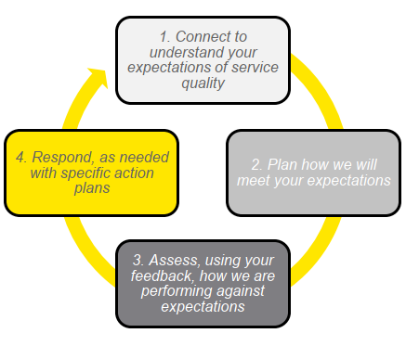
J.2 - EY Quality Assurance Process
Connect: In the initial step, EY engagement partner will meet face to face with you to understand your specific service and relationship expectations before we start our work. We will use our standardized Expectation of Service Quality (ESQ) tool to structure this discussion, and EY will update this throughout our engagement during subsequent QA meetings.
Quality Planning: At this stage, EY will specifically plan how we will meet those expectations during our service relationship first step in implementing quality management.
Assessment: EY will then objectively assess and assure delivery quality through regular Assessment of Service Quality (ASQ) meetings with key stakeholders. At these checkpoints, feedback will be sought from you on our performance, the quality of work products and general level of satisfaction with the project progress. The diagram to the left shows the four steps of our SQ process cycle.
Respond: We respond to your feedback by agreeing specific relevant actions with you and incorporating those back into our plans. EY Quality team will then work to confirm that the feedback has been received and required actions are understood and will subsequently monitor progress against these actions.

Slide 60
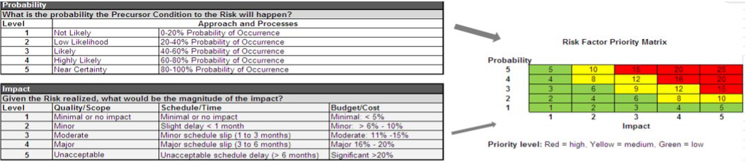
Risk and Issue Management
Identify: EY works with you to ensure the necessary controls are in place to monitor and respond to risks and issues as they arise. The objective of risk identification is to identify risks directly relevant to the engagement, without creating an exhaustive listing of every possible negative eventuality. ​
Assess: Risk assessment provides the opportunity for EY and stakeholders to work together to develop consensus on risks. This is best accomplished as a collaborative effort and should be guided by the use of a risk factor priority matrix – which measures the probability of risk occurrence and severity of risk impact, as shown in the following diagram:
Mitigate: A risk management strategy will be developed for each identified risk to minimise or eliminate risk impact. Risk strategies will be incorporated throughout the project life cycle to limit the potential impact of project risk. Some risk strategies will have a cost and we help you to assess consequences against costs.​
Track & Report (risk controls): It is critical that Risk Management meetings take place on a weekly basis to monitor risks regularly and the ensure timely communication and escalation where appropriate. The effectiveness of the corrective or preventative action is also assessed and risks will be allocated a trend to clearly indicate whether risks are being effectively treated or otherwise.​
The approach above is fundamental to the success of projects. Regular management of project risks is a key activity and successful projects identify risks early to prevent them from becoming issues. Project issues are also stored on RAID log and are managed using a similar process with clearly defined priority, impact, actions, owners and target resolution dates.

Slide 61
Health Inputs
Case Study – Laboratory Testing

Slide 62
Testing Methodology
EY will implement a comprehensive testing strategy that clearly articulates who, what, when and how testing will be conducted throughout the course of the project. EY’s overall delivery methodology provides a framework for how we typically sequence the various types of testing required over the course of the build & test phases. Our delivery method also provides a standard set of approaches, activities and deliverables that need to be produced to prepare, execute, manage testing activities. We will work with all stakeholders to ensure the roles and responsibilities for carrying out these activities are agreed and clearly understood.
Test Planning
Tooling
Management
Execution
Each type of testing - unit testing during build sprints, integration testing, user acceptance testing (including security testing) and performance testing - will require its own planning approach.
EY will play a pivotal role in helping the project develop the overall integrated test strategy across all workstreams and activities.
The EY Test Lead will form part of the overall PMO team structure and therefore will be very close to the heart of all planning throughout the project.
EY recommend using Microsoft Azure DevOps to help orchestrate testing efforts & generate test cases. This is tightly integrated to the Requirements-to-Deploy process with an audit trail back to business requirements.
Test Status & Tracking: Accurate, measurable reporting is a cornerstone of the EY Test Management approach. Regular reports will providing plan v actual progress made, a summary of any blockers, dependencies, risks, and issue, as well as a Defect summary providing counts of defects by status and severity. Risk & Issue Management: Test management will integrate with our Risk & Issue management process with early warnings & mitigations provided. Actions & Dependencies: We will track any actions that arise from testing, to feed into other test phases or workstreams, along with any dependencies that emerge.
EY will ensure that after a test object is ready for testing, and entry conditions for test execution are met, that testing is completed in a controlled and structured way. Testing will be conducted as per the defined test cases executing the appropriate build item and comparing the expected and actual results.
A clear defect resolution process will be implemented across all stage of testing, including hypercare. Defects will be identified, tracked and closed out during each test cycle, according to severity & priority level. Regular Defect Status calls will be used to monitor progress, with escalations to leadership as required.
Deliverables
EY will align with all stakeholders during the Prepare phase of the project on test deliverables, e.g., test scripts, status reports, test result sign-off etc. to make sure that your expectations are met. We can leverage the EY suite of test deliverable templates to augment the above.

Slide 63
F.3 – Training & Knowledge Transfer

Slide 64
E.2 - Training / Knowledge Transfer
EY has a well developed, tried & tested approach to training, which we see as a key transformation enabler within the business
SAP Enable Now
1. Understand needs
Design a training strategy and approach to identify impacted roles and processes
Early and ongoing engagement with stakeholders in all divisions to understand change impacts
Serves as input to the learning curriculums, courses and ongoing support needs
3. Develop materials
Accelerate content development with what we know already works (engaging storytelling speed and relevant formats) at scale to reduce cost per session
Leverage modular format to support consistency, quality and speed while scaling
Provide localisation/translation support for different geographies
Develop personalised and experience-based content
5. Ongoing Enhancements
Provide hyper-care support to the client super users and support any refresher training knowledge
Agile facilitators to continually collaborate with stakeholders to enhance the learning experience
Understand
needs
Develop
materials
Ongoing
Enhancements
Design
content
Deliver
Training
2. Design content
Create a role-based training curriculum by leveraging needs assessment
Combine global content + local context for relatable, contextual materials that will stick and encourage behaviors to change
4. Deliver Training
Conduct Train-the-Trainer sessions to prepare super users for end-user training
Equip client practitioners with knowledge of Cloud Storage Technology processes to deliver an exceptional and consistent learning experience – enhancing knowledge transfer and business ownership

Slide 65
E.2 - Training / Knowledge Transfer
EY has a well developed, tried & tested approach to training, which we see as a key transformation enabler within the business
Knowledge Transfer (KT) is the transfer of knowledge, partial services, and processes from a transferring unit to a receiving unit. Training / KT focuses on the upskilling of stakeholders through the transfer of skills and knowledge between knowledge holders and designated knowledge receivers. It initially forms part of the Operational Readiness criteria under the Build Phase (Phase One) of the Implementation Plan, where the existing skills are identified, and the KT plan and methods are finalised. It then continues into the Transition Phase (Phase Two), where the planned methods are executed and measured and the Sustain Phase (Phase Three), where the initial trainings have been completed and any further required trainings are carried out on an ‘as and when’ basis.
KT will assess the resource requirements for training, testing, and performing the processes and develop a plan on how this will be achieved before, during and after the implementation of Cloud storage services.
F.1.1 Training / KT Objectives
The objectives of Training / KT are to:
Build capabilities and support the preparedness of the St. James's Hospital Cloud Storage services in advance of the change taking place.
Capture and manage the knowledge that is most important to perform the processes and activities.
Organise, create, capture, and distribute knowledge, ensuring its availability for future users.
Promote collaboration and information sharing across the St. James's Hospital Cloud Storage services team.
Promote and encourage a knowledge-driven culture by which innovations are stimulated.
F.1.2 Training / KT Plan Key Elements
Key elements of the Training / KT Plan include:
Developing and implementing the Training / KT approach for the project (focused on experience at individual ETBs).
Designing and executing a comprehensive Training / KT Plan, and communicating with stakeholders on it.
Capturing the Training / KT targets and metrics.
Tracking and measuring progress of Training / KT through Knowledge Gap Analysis with the trained stakeholders.
F.1.3 Training / KT Plan Scope
Scheduling training sessions, this includes in person and virtual trainings, and the organisation of work shadowing / reverse work shadowing.
Upskilling the St. James's Hospital cloud storage services team in all incoming process changes.
Conducting ‘Train the Trainer’ sessions with St. James's Hospital Cloud Storage services team who will go on to train and upskill other stakeholders.
Where Transition Leads will go on to upskill St. James's Hospital Cloud Storage services team, they will receive relevant ‘Train the Trainer’.
All documentation produced will go through a quality review process and once approved will be stored within the Quality Management System.

Slide 66
F.
Managed Service
F.1 – Managed Service
F.2 – Benefits of our Support Offering
F.3 – EY Managed Service Event Categorisation
F.4 – Support Levels Structure
F.5 – Support Operating Model
F.6 – EY Managed Service – Transition Quality
F.7 – Performance Reporting

Slide 67

F.1 – EY Ireland Managed Service Overview
Our team in EY Ireland have been providing Managed Service support for over 10 years covering a wide suite of applications. We will provide support and maintenance as well as continuous improvement services for the Cloud Storage Technology Service for the Central Pathology Laboratory at St James’s Hospital.
The services that we provide can be summarised into three categories. They are transition in, solution support and continuous improvement.
Transition-In Services – comprehensive transition activities including the setup of support services and training of managed services support;
Solution Support – Managed Services, providing maintenance, application security patching and incident management;
Platform Support and Maintenance - The provision and/or management of infrastructure for the hosting of the platform.
Application Support and Maintenance – Ongoing real-time monitoring/alerting, patching and maintenance of the digital applications;
Continuous Improvement Services – EY Consulting Services covering platform enhancements, system upgrades, problem management and investigation, application testing, and performance improvements.
EY’s Managed Service team is a responsive, local team focused on providing enterprise application and infrastructure support that’s secure, scalable and sustainable for your business. Our team, spanning Ireland, business hours and provides 24x7 support for highly technical client solutions, and infrastructure for government agencies and large multi-nationals and not-for-profit enterprises.
We provide support for critical government and industry digital solutions across Ireland with customised support structures, processes and SLA’s suited to each specific client. We will provide the confidence to your team and key stakeholders that the platform is well supported through excellent communication and a pro-active approach to issues and any incidents.
Our continuous improvement team offers a range of consulting services, with relevant expertise to St. James's Hospital in design, technology, management, analysis and strategy. Whether it be solution enhancements, design uplifts, platform configurations or large-scale application delivery projects, our team of experts are tried and proven within the Microsoft technical ecosystem.
Digital platforms are an ongoing journey and not a set and forget IT asset, with often complex business logic, system integrations and customised content the platform provides a solution that users and the organisation rely on. As business needs change constantly the solution must remain relevant and capable for today and the future.
EY Managed Service is a capability where the primary function is to provide application and infrastructure support for clients across the globe.

Slide 68











F.1 – EY Managed Service
EY combines deep experience, leading talent and unparalleled technology with a global delivery model that supports your business wherever, whenever you are – giving you the confidence and freedom to drive your business forward.
With EY Managed Service our dedicated team will provide, 9AM to 5PM Monday to Friday, support for the Cloud Storage Technology solution, this will include Core Support Services and overall Platform application support.
EY Managed Service provide services based on your current needs, with the flexibility to build customised cloud solutions that match your specific needs.
EY will provide St James’s Hospital with:
Support Coverage: 9AM to 5PM Monday to Friday
Support for Incidents, Changes, Problems, Service Requests, and Enhancement Requests related to all components of the solution
Support Continuity: An on-shore single point-of-contact for all escalations and a team of resources that know you and the platform
Resolution Management: EY will provide end-to-end resolution management working with vendors and internal teams as necessary
Commitment to Quality: Providing a Subject Matter Resource (SMR) and Service Manager to enable quality and operational excellence
EY Managed Service
Cloud Application - Support Activities
Additional functional offerings available
APPLICATION
App Support
MS Dynamics - CRM
Data Engineering
SAP
Database Support
Dev Ops Service
Service Now
Security Operations Centre
CORE SUPPORT SERVICE
Cloud Platform – Support Activities
Azure, AWS, SAP Cloud, Google Cloud Platform, M365, ServiceNow
PLATFORM
Architecture & Design
Monitoring & Alerting
Resiliency
DevOps for Platform
Availability
On-call
IAM
Security
SLO Definition
IPC Mgmt.
Cost Optimisation

Slide 69
E.2 – Benefits of our Support Offering
Transparent, secure service across our support team
We offer target Service Level Agreements (SLAs) for response and resolution of incidents, providing our customers with peace of mind that their issues will be handled within appropriate timescales.
Microsoft escalation path and roadmap awareness
Our strong relationship with Microsoft through our EY – Microsoft Alliance means that we can coordinate escalation with Microsoft on your behalf, where required. This helps us to collaborate with the right resources and enables us to reach an appropriate resolution.
Long-term customer relationships
St. James's Hospital will have an assigned Service Delivery Manager who will notify you of any Microsoft changes that may affect you, make recommendations for system improvements based on tickets raised, and act as a liaison between the support team and your Engagement Partner to ensure a high quality of service.
Communication and Escalation
EY places great emphasis on communication and collaboration as key elements of successful incident management. We will establish a well-structured communication process, including dedicated points of contact and a clear escalation matrix. This will enable seamless coordination with your team, ensuring that incidents are promptly addressed and escalated to the appropriate stakeholders when necessary.
EY Team Expertise
Our team consists of highly skilled professionals with extensive experience in incident management, IT infrastructure, and system administration. With our diverse expertise, we are confident in our ability to address a wide range of challenges and deliver reliable solutions in an efficient manner.
Consistency from project to support
Our Managed Services team works closely with the rest of our Microsoft Services Group, giving them access to an extensive team of full-time technical staff. Working closely with consultants and project managers gives the team early awareness of our projects before each organisation transitions to a supported customer. It also means they can quickly speak to the individuals involved in delivering each project should they need further insight into the systems delivered.
Adherence to Microsoft guidelines and processes
We embrace the standards of Information Technology Infrastructure Library (ITIL) and have incorporated ITIL-related guidance and processes within our team. We always recommend deploying support fixes following our governance process with stages of development, user acceptance testing, and then into production, driving a smooth deployment to your users.
Continuous Improvement
At EY, we prioritize continuous improvement to enhance our services continually. We will conduct regular reviews of our incident management processes, response times, and event categorization methodology. This iterative approach allows us to identify areas for improvement and adapt our strategies to meet your evolving business needs effectively. The areas above and additional information, will all be detailed within a monthly report, produced and presented by the Service Delivery Manager.
Flexibility and Collaboration
EY understands that each organization has unique requirements. As a result, we are committed to tailoring our services to align with your specific needs and objectives. Our team will work closely with your stakeholders to seamlessly integrate our incident management processes into your existing systems and workflows. Collaboration will also be present when we have Technical Support available during visits from the Irish National Accreditation Board or similar. EY will facilitate an independent security review (penetration testing), by a specialist company contracted by SJH and collaborate with them in the resolution of any security issues highlighted by them.

Slide 70
E.3 - EY Managed Service Event Categorisation
Some examples of Event Categorisations:
EY recognizes the criticality of event categorization in ensuring effective incident management. To achieve this, we will define four distinct categories based on the requirements given in the tender document.
Critical Priority: Events classified as critical are of utmost significance, necessitating immediate attention due to their potential to cause substantial business impact or system disruption.
High Priority: Events that fit under this category have a big effect on operations and need to be dealt with quickly to prevent any further effects..
Medium Priority: Events with a medium priority may have some effect on operations, but they are not urgent. However, they will be attended to promptly and with devotion.
Low Priority: Events falling into this category are those with little or no effect on operations or those that can be fixed during ordinary maintenance procedures.
Target Response Time:
Critical Priority: Within – 30 mins from the time of event identification.
High Priority: Within – 2 hours from the time of event identification.
Medium Priority: Within – 6 hours from the time of event identification.
Low Priority: Within – 12 hours from the time of event identification.
For example in a critical priority incident, an email goes to all key stakeholders, and the Managed Service team open a call with the key stakeholders and the call remains open until the issue is resolved. Managed Services team will include additional subject matter resources to the call for regular updates and any relevant input, while the issue is worked on in the background.
EY is committed to having clear lines of communication with all relevant parties and providing regular updates on the issue, findings/route cause, next actions, and ETA’s as to when the incident will be resolved.
Event category | Resources | Examples
Critical Priority 🔥 | Virtual Machines (VMs) | VM instance failure causing critical applications to go down.
 |  | Disk corruption leading to data loss.
 | Azure Databases | Complete outage of Azure SQL Database or Cosmos DB affecting critical data access.
 |  | Corruption of critical data in databases.
 | Azure Networking | Critical network infrastructure outage resulting in loss of connectivity to important services or data centers
High Priority 🔶 | Virtual Machines (VMs) | VM performance degradation affecting non-critical applications or services.
 |  | Disk space exhaustion leading to the inability to write new data.
 | Azure Databases | Partial unavailability of Azure SQL Database or Cosmos DB affecting specific non-critical data access.
 |  | Performance slowdowns in databases impacting application response times.
 | Azure Storage Accounts | Performance issues affecting non-critical applications or services
 |  | Partial unavailability of storage accounts impacting non-essential data access.
Medium Priority 🟡 | Virtual Machines (VMs) | Performance issues affecting non-time-sensitive applications.
 |  | Non-critical VM reboots or instance failures.
 | Azure Databases | Minor performance issues in non-critical databases.
 |  | Data replication delays for non-critical data.
 | Azure Storage Accounts | Performance degradation of non-critical storage accounts.
 |  | Minor access issues for non-essential data
Low Priority 🟢 | Virtual Machines (VMs) | Non-critical VM status or configuration changes.
 |  | Low impact on VM performance that does not affect critical applications.
 | Azure Active Directory (Azure AD) | Non-critical changes to non-essential user accounts or attributes.
 |  | Informational synchronization logs.
 | Azure Key Vault | Minor access logs or informational key usage.
*Above outage examples are not limited and may vary depending on the situation

Slide 71
E.4 – Support Levels Structure
EY Managed Service operates within a tiered support model, comprised of distinct tiers, or levels. Below is a description of the support levels and examples of how they interact with each other through the typical support process:
Level 1 (EY Managed Service)
Level 1 is the first line of support for St. James's Hospital. Level 1 support in this case will be a fully managed IT Service desk, manned Mon – Fri 9AM to 5PM.
Typically, Level 1 solutions are in a FAQ or a knowledge base. When a Level 1 support employee is not able to resolve the issue, they classify the issue and raise it with Level 2 support.
Key responsibilities include:
First contact point for all customer related queries and issues
Log internal tickets on behalf of end-users
Collect and collate relevant issue information
Communicate documented and established workaround to internal system users
Identity and Access Management
Escalate to Level 2, when required
Level 2 (EY Managed Service)
Level 2 support involves solution knowledge. The support engineer determines whether this issue is new or a pre-existing one. Advanced diagnostic tools may be used, and data analysis may be done at this point.
Fixes for logged tickets will be communicated back via the client’s internal service desk for end user issues or directly to IT resources for system related items.
Key responsibilities include:
Investigation and resolution of raised tickets
System Health and Performance
BAU Operations and Systems Administration tasks for solution components as defined
Internal escalation to EY technical consultants (if required)
Maintain knowledge base with known issues and fixes
Level 3 (EY Managed Service)
Internal escalation requires a person who has specialist solution skills over and above the work the support engineers do in Level 2.
They deal with complex issues from configuration right through to development including thorough knowledge of connected systems.
To solve the problem, they will collect as much data as possible from the support staff at Levels 1 and 2.
Key responsibilities include:
Investigation and resolution of raised tickets and noted bugs
Communicate with customer as required
Escalation to Level 4, when required
Assist with Level 4 as necessary
Level 4 (Microsoft)
Level 4 support provides for delegation or referral of an unresolved Level 2/3 issue to Microsoft for further investigation and remediation. This service would be initiated on behalf of the client by the EY Managed Service Team.
Key responsibilities for Level 2/3 (EY) Support include:
Logging of tickets in the vendor support system
Communication with the vendor support representative
Communication medium between St James Hospital and vendor
Key responsibilities for product vendor include:
Product issue and problem resolution
Provision of software updates
Ticket status updates

Slide 72


E.5 – Support Operating Model
An onshore dedicated support team within Ireland; with named personnel familiar and known to St. James's Hospital.
Daily Support coverage on a dedicated hotline/helpdesk manned from 9 AM to 5 PM (Ireland Time) Monday to Friday
We are happy to facilitate Incidents, Problems, and Change Management through your ITSM Tools and Processes.
EY Service Delivery Manager.
Essential maintenance for the Cloud Storage Technology solution across Production and Non-Production environments
Service Management & Account Management
SLA
Knowledge Management
Level 1
Business Tickets Triaging, First Line Incident Management
EY Support Model
EY Managed Service - IT Service Desk
User Management
First Point of Contact
General Solution Questions & Answers
Account Team
Level 2/3
Application Monitoring and Support Management
Azure Platform
Application insights of storage services
Logs of cloud storage services
EY Managed Service
Internal Escalation (EY SMR)
Process
Application Support and Defect Fixes
Azure Platform
Cloud storage services
Related resources of cloud storage services
Metrics & KPI
Level 4
Vendors (Microsoft)
EY Development Team (Not included in Managed Service Offering)

Slide 73
E.6 – EY Managed Service – Transition Quality
EY’s five-stage approach to equipping our EY Managed Service team is closely managed, with exit criteria defined at each stage to drive quality across the process
Phase
Planning
Knowledge transfer
Job Shadow
Reverse Job Shadow
Steady state
Scope Validation
Governance Set up & tools
Identify detailed transition requirements
Perform gap assessment
Finalise transition checklist
Develop Detailed Transition Management Plan
Staff ramp-up, recruitment
Self learning through pre-reads
Formal training
Process walkthrough
Artefacts walkthrough
Key frameworks and principles
Key SMRs from EY & St. James's Hospital
Collation of documents
Identify KT gaps
Transfer of access and infrastructure support
Knowledge transfer through:
Shadow support
Interfacing with other teams & stakeholders
Mock drills and failures
Assisting in Reporting & Tracking
Observation and evaluation of the designated resource on:
Client facing support tasks
Leading operational activities
Interfacing with other teams & stakeholders
Managing tasks solely
Assisting on high complexity changes & high severity tasks
Approval to proceed, Go/No-Go
Execute Cut-Over of all role responsibilities
EY Managed Service Commence
Service Management Meetings
Approach
Identify risks from projects critical resources
Review in-flight activities and other dependencies
Applications potentially being sunset
Document KT gaps and plan for addressing them
Gaps in existing documentation
Requirement of additional KT time for any specific area
Dependencies on non-KT activities
Identify any KT gaps and plan for addressing the same
Agree out of scope activities, if any, and finalise approach for the same
Identify pending KT tasks, if any, and complete the same
Fine tune operating model and service mgmt. framework
Evaluate gaps, if any, for transition completion
Focus
Exit
Approved transition plan & schedule; resource mapping
Checkpoint
Checkpoint
Checkpoint
Checkpoint
Gate1
Complete documentation of processes, & artefacts
Gate2
Knowledge training completed & signed off
Gate3
Transition signed off
Gate4

Slide 74

E.7 – Performance Reporting
As part of our Service Management activities, your Service Delivery Manager will produce a recurring report which will include:
1
Ticket Summary
2
Monthly Report
Client X
April 2023
Incidents, Platform Availability & Problems
3
Platform changes including security updates and maintenance activities
4
Submitted Service Requests
5
Active and Backlog Incidents
6
Production Platform Performance
7
Maintenance recommendations (if applicable)

Slide 75
G.
Assumptions

Slide 76
G.1 – Our Detailed Assumptions
Ref | Description
1 | We assume a start date once contracts are signed of w/c 01st September 2023. We anticipate a lead time of 1 week for all EY resources once start date is confirmed.
2 | The scope of the project will not change/increase from current requirements as set out in the RFP.
3 | Further clarifications and business process diagrams will be initially provided from Saint James Hospital.
4 | Timely availability of Saint James Hospital regional process Lead, subject matter expert and super user resources as described in the RFP in each impacted region.
5 | St. James's Hospital Project Governance resources will be made available as described in the RFP.
6 | We have assumed that Business Change (including Engagement and Readiness) will be a St. James's Hospital led and delivered activity supported by one Business Change EY FTE.
7 | We assume Saint James Hospital have agreed data owners that are accountable for data quality and will perform the required pre-migration cleansing activities .
8 | The EY data migration lead will provide the framework and approach for migrating data and will implement the data migration.
9 | The volume of data to be migrated to the new solution will be agreed during the Analysis and Design phase.
10 | St. James's Hospital will be responsible for the provision of clean data from source systems and will provide any enrichment required for entry into the proposed solutions data storage locations, for example, SQL databases and file stores.

Slide 77
G.1 – Our Detailed Assumptions
Ref | Description
11 | St. James's Hospital will identify and migrate any risk to data flows in the current system(s) which may be caused by introducing new data storage locations.
12 | A Train-the-Trainer approach will be adopted to equip Saint James Hospital and core project resources to deliver end-user training.
13 | We assume a ‘phased’ rollout and deployment approach across all outlined regions.
14 | Proposed solution Deployment Roadmap will be provided during the Foundations phase to avoid any conflicts in deployment planning.
15 | St. James's Hospital will ensure the necessary technology infrastructure is available when required.
16 | Access to client resources, systems, relevant documentation in a timely manner is fundamental to the success of the implementation.
17 | Regular update/release windows during test phases to be agreed during Foundation phase.
18 | Business sign off will be made in a timely manner with a clear escalation path defined during the Foundation phase of the project.
19 | Development of training materials will be the responsibility of EY with support as required from St. James's Hospital.
20 | Changes to the St. James's Hospital resourcing model will be agreed through the project governance structures.
21 | It is assumed knowledge transfer activities will take place throughout the lifecycle of the project with particular focus on formal training, preparation for deployments, hyper care and transition to managed services.
22 | The current Linux version is not supported on Azure, and it will be required to upgrade it to one of the supported versions, so EY will need the help of St. James's Hospital and their vendors to validate that there are no compatibility issues with the Sortware or the application with the new version. ( Can be tested first in UAT / Pre-Prod environment )

Slide 78
G.1 – In Scope
Ref | Description
1 | Infrastructure Provisioning (Compute, Storage, Network, Monitoring & Security)
2 | Data Migration (Flat file)
3 | Database Migration & Restoration (Laboratory)
4 | IaC for Infrastructure management and on demand provisioning
5 | Documentation (Knowledge Transfer & Training)
6 | Unit Testing and UAT (Validation of Infrastructure, Networking & Database)
7 | User Acceptance Test plan support for solution validation
8
9
10

Slide 79
G.1 – Out of Scope
Ref | Description
1 | Application Migration & Compatibility support
2 | Third party software ownerships & responsibilities
3
4
5
6
7
8
9
10

Slide 80
H.
Credentials

Slide 81


H.1 – Our Relevant Credentials
EY understands that selecting the right solution for this program of work is critical, we are confident that our case studies will demonstrate that EY has the necessary business and technical capabilities to deliver.
Each one of our case studies outlines a set of challenges faced by a customer and how EY delivered, building trust with our partners, demonstrating our expertise with an ability to execute meeting critical business challenges
EY delivered an end-to-end case management solution and contact centre service for the HSE to notify all individuals who were impacted by their cyber-attack in 2021 and subsequent data breech. The solution utilised the full breadth and depth of Microsoft’s Cloud Platforms including Power, Dynamics and Azure. EY managed the formulation of processes to ensure the “human at centre” approach to the design and implementation of the full service. EY provided a 24/7 operational Managed Service for the solution.
Data Subject Notification (DSN) and Contact Centre Service
EY delivered an Azure Data Platform, enabling data integration from various sources to model the disease's (COVID-19) impact and offer situational dashboards for decision-making. The platform empowered HSE management with comprehensive situational awareness, enabling them to monitor patients, access hospital resources, track ICU availability, analyse recovery rates, and manage resources effectively during the pandemic's phases.
Covid19 Data Lake and Reporting
EY successfully migrated Screenlink legacy System to Microsoft Azure in 2020, resulting in upgraded servers, improved data security, and increased flexibility for future engagements. EY addressed challenges posed by ageing technology, lack of flexibility, compliance risks, and rising costs in Screenlink Healthcare's legacy systems, EY's solution included technology upgrades, migration to a modern cloud-based environment, and enhanced security and cost-efficiency.
Onsite to Cloud Migration

Slide 82
H.1 – Case study 1: HSE - Data Subject Notification (DSN)
Driver & Background
Value delivered
Why Relevant for St. James's Hospital
In May 2021, the CHI was impacted by a large-scale cyber incident. Following the HSE’s ransomware attack there was an obligation on the HSE to inform all those impacted by the breach. EY were engaged to manage the “end to end” notification process for the HSE. This was a highly complex engagement due to:
The nature and risk the data breach, which included sensitive and confidential information.
The need for the organisation to rebuild and regain trust with citizens in the delivery of this service.
The complexity of the legal and regulatory requirements that needed to be met in delivering the service.
The technology requirements to provide a service at pace to manage the notification, communications and for overall case management at speed and scale.
The high-profile nature of the impact of the cyber-attack.
EY delivered a full “end to end” solution for the HSE utilising Microsoft Cloud services (Azure, Dynamics, Power Platform and DevOps) integrated with 3rd party contact centre software (Twilio) and identity verification service (ID-Pal). EY developed the processes required to manage the notification and follow on management of communication and advice that was provided to affected citizens. This led to a successful outcome that achieved the following:
Letter notification and case management for over 130,000 affected citizens.
Provision of a highly secure public portal to provide data sharing capability and communication to affected citizens.
Ensured the HSE met their GDPR notification requirements in a timely manner.
The solution delivered in this case highlights EY’s ability to deliver critical services utilising Microsoft Azure and Power Platform services aligned with an agile delivery methodology to deliver value early and at pace. This demonstrates EY’s:
Strong focus on User Experience (UX) supported by Microsoft’s Power Platform and resulted in a positive user experience and improved communication, for better management and coordination.
Significant technical depth to design and implement a fully operational cloud hosted customer contact centre and supporting technologies within 10 weeks of project initiation.
Ability to design and implement complex integrations, with 3rd party tools.
Capability to provide a full 24/7 Managed Service for a large-scale implementation of national significance., including training of all HSE staff – pre and post go-live, creating detailed process documentation for all aspects of the solution e.g. Backup/Recovery processes and delivering to strict SLA’s for incidents and escalations.
Seamless migration of large volumes of data from Relativity to Azure, ensuring data integrity and accuracy during the process.
Case Reference: brian.moroney@ie.ey.com

Slide 83

H.1 – Case study 2: HSE - Covid19 Data Lake and Reporting
Driver & Background
Value delivered
Why Relevant to St. James's Hospital
Amidst the Covid-19 outbreak in Ireland, the Health Service Executive (HSE) recognized the urgency to organize and respond effectively. The HSE established the National COVID-19 Management Team on March 6th and shortly after, the newly formed Integrated Information Service (IIS) received a request to create a dashboard consolidating information from the front line (public and private hospitals, labs, and 3rd parties) to provide a clear view of the evolving situation and the organization's ability to respond. EY was enlisted to support the response to the Covid-19 crisis.
The result was the IIS COVID-19 Management Dashboard, offering real-time insights into confirmed cases, their severity, and hospital capacity at public and private institutions, evolving in tandem with the crisis.
The HSE's critical business need was to integrate data and systems to enhance decision-making and improve outcomes, offering the following:
During the Covid-19 crisis and the increased urgency at the time, the HSE needed a comprehensive dashboard displaying patient journeys, including GP referrals, testing results, hospital and ICU admissions, discharges, and Covid-19 presence in community facilities. The goal was to facilitate a cohesive understanding of the situation across the HSE.
Practitioners and management required timely, detailed information to make optimal decisions concerning patient care, planning, and strategy development.
Validating data sources and delivering accurate, actionable information at the necessary level of detail was a crucial objective.
Considering the extended response period, automating metric delivery was necessary to ensure their availability, while redeploying resources for other analytic projects.
EY's selection was justified by its longstanding relationship with HSE and its broad resources within the Technology Consulting Competency, coupled with extensive experience in Microsoft Azure technologies, as detailed below:
EY's expertise was key to successfully importing data from multiple on-premise labs to the Azure Data Platform. This data consolidation and migration allowed for accurate modelling of the disease's impact, effective planning, and the creation of situational dashboards to aid decision-making.
Despite the challenging timeline, EY managed to establish the complex platform, integrate multiple data sources, and continue offering crucial insights in response to the unfolding crisis, when urgently required.
The Azure Data Platform components included Data Lake, Data Factory, SQL Database, & Databricks, among others, enabling HSE management to have full situational awareness and informed decision-making throughout the Covid-19 patient lifecycle across various health systems, ultimately supporting the nation's response and recovery.
Case Reference:

Slide 84

H.1 – Case study 3: Screenlink - Onsite to Cloud Migration
Driver & Background
Value delivered
Why Relevant to St. James's Hospital
Screenlink, a leader in diagnostics tests supply, works with the HSE and National Screening Service to provide diagnostic tests and logistics.
As their technology partner, EY supported two core systems: the Fit Kit Management (FKM) System and the LBC Stock Control System. These systems have been reliable but were faced with challenges arising from ageing technology, software, and hosting environment.
Ageing technology: The Systems were running on ageing technology. This could lead to security vulnerabilities and system instability
Lack of flexibility: The current hosting environment is not flexible enough & this could lead to problems with scalability and performance
Compliance: The use of out-of-support software & system stability issues could pose problems in an NSS audit
Costs: Rising cost of hosting in current environment.
Disaster recovery: High dependency on hardware infrastructure without disaster recovery strategy in place which could lead to significant downtime in the event of a hardware failure or natural disaster.
EY was brought in to modernize the IT Infrastructure for Screenlink. EY upgraded the underlying technology to the latest versions and migrated the infrastructure to a modern cloud-based environment (Azure).
This offered the following benefits:
Transitioning to modern technology will help Screenlink avoid compliance issues, especially in relation to the HSE, while adhering to ISO standards
Upgrading to modern database platforms ensures improved data security, vital for sensitive healthcare information
The migration ensures high availability and disaster recovery options, safeguarding against unexpected disruptions and minimizing downtime
Modernizing the infrastructure with a cloud-based approach equips Screenlink to swiftly respond to future requirements, adapt to market changes, and remain competitive
The migration will eliminate the increasing costs associated with the current hosting environment by allowing screenlink to pay on the go for only services that they use.
For Screenlink, continuing with EY and migrating to Azure had many benefits. EY followed best practices in migrating of VMs, data and databases to improve security, reliability and availability, this overall approach is similar to the need for a fully managed Cloud Storage Technology Service at SJH.
EY designed, developed and supported Screenlink’s systems before and after the Azure migration. As such we were best placed to conduct the migration and did so successfully. We see ongoing benefits arising from the decision to move to the cloud
EY's proven track record in successfully migrating critical systems, as showcased in the Screenlink project, assures SJH of a seamless transition
The Screenlink project demonstrates EY's capability to modernize databases, enhancing efficiency and security which is a key consideration for SJH
EY's focus on compliance aligns with SJH's requirements, ensuring for a smooth migration without compliance concerns
This accomplishment demonstrates EY’s expertise in system modernisation, seamless transition & delivering value
Case Reference:

Slide 85
I.
Our Team

Slide 86







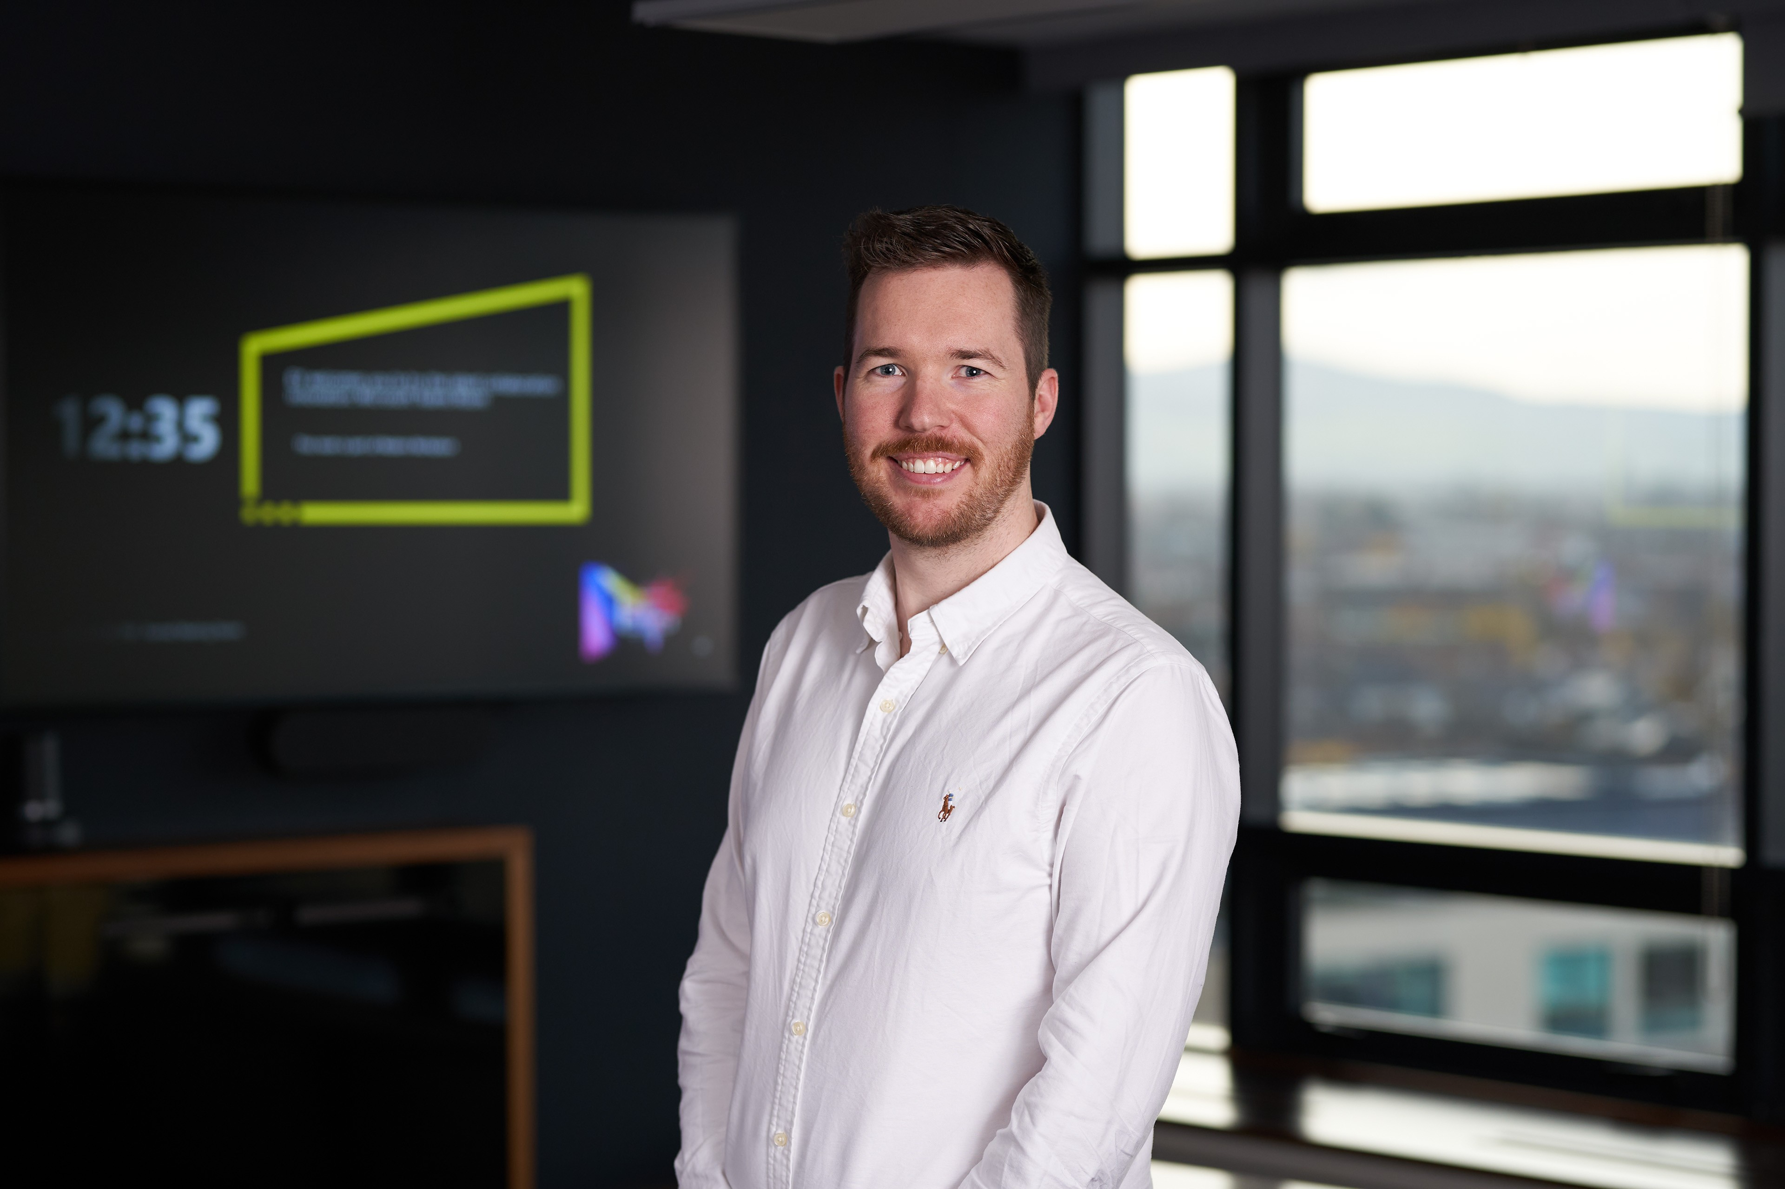




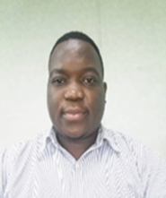

I.1 – Our proposed Delivery Team
Engagement Leadership
Subject Matter Resource
Shane MacSweeney
Paul Browne
Brian Moroney
Kevin Culligan
Account Lead Partner
Engagement Partner
Quality Assurance Partner
Health “SMR”
Jane Noble
Laboratory “SMR”
Mick Mooney
Brian Bambrick
Enterprise Solution Architect
Delivery Manager
Andrew Sheppard
Health “SMR”
Health Sector Experience
Core Delivery Team
Ahmed Helmy
Oyinlola Popoola
Ashwini Kokitkar
Cillian Bissett
Wisdom Magadu
Cloud Engineer
Cloud Engineer
Cloud Engineer - IDAM
DevOps Engineer
Database Administrator
Suresh Kumar Namballa
Test Lead

Slide 87

I.1 – Team member bios
Paul Browne
Selected professional experiences
Health Service Provider
Technical Lead on programme to notify 150k + citizens whose data was affected by cyber incident. Led team (50+) to design, deploy and operate solution on the Microsoft Cloud platform
Lead Technical Architect for the deployment of Azure hosted Data Analysis and Warehouse platform
Technical Delivery Lead for Cyber Response with responsibility for securing Cloud Identities and Platforms, and the restoration of Cloud Services in a safe and secure manner
Technical Delivery Lead on Cloud Identity and Office 365 platform design, implementation and configuration. Proof of Concept for initial cohort of users with compilation of full migration process
Energy Company
Cloud Technical Lead on cloud adoption, design and roadmap planning including formation of Cloud Desk, Digital Factory and DevSecOps adoption and strategy
Global AirCraft Leasing Company
Lead role assisting in the transformation of their IT delivery to an Azure Cloud based technologies
Technical Delivery Lead for design, implementation and configuration of Azure based Global Enterprise Landing Zone
Life Assurance organisation
Assist in the definition and formulation of Cloud Target Architecture and DevOps adoption
Energy Regulator – UK
Technical architecture lead on Cloud Adoption roadmap, Azure Design & Implementation for energy schemes which pay out over £10B per year
Assisted with DevOps adoption (toolset design and implementation) to meet National Cyber Security Centre guidelines. Trusted advisor on Azure cloud platform
Oversaw scoping, planning and design for migration of 2 datacentres to Azure and Office 365
Technical Lead on implementation of Enterprise scale Azure Landing Zone
Insurance company
Lead role in the migration from 2 datacenters to Azure of their core business operating technology platform
Implementation of full DevOps operations model
Large International Bank
Performed a “Go-Live” Readiness Assessment for the banks Azure Platform hosted SaaS service (€30m project)
Partner
EY Technology Consulting
Proposed Role: Engagement Partner
About Paul
Paul is a Partner in the Technology Consulting practice of Ernst & Young LLP with a focus on Cloud Platforms and Engineering and has 25 years IT consulting experience. Paul is Head of the Microsoft & Cloud Services Group in EY in Ireland and manages teams (70+) of Cloud Architects, Consultants and Engineers on project delivery engagements
Paul has in-depth enterprise architecture consulting experience and extensive cloud consulting experience (roadmaps, maturity assessments, TCO) across Azure, AWS, OCI, OpenShift/Containers and DevOps technologies
Paul has carried out academic research on DevOps adoption challenges in large organisations and has a comprehensive understanding and experience on enterprise DevOps adoption
Prior to joining EY Paul held numerous senior technology leadership positions, both strategic and operational, including Head of Cloud Consulting, DevOps Team Lead and Senior Infrastructure Architect for both consulting companies and clients
Skills
Technical Leadership
Cloud Strategy Development
Cloud Adoption
Transformation Planning and Execution
Enterprise Cloud Architecture
Cloud Engineering
Cloud Operations
IT Service Management, including Modern Operations and Evergreen
DevOps Strategy, Design and Implementation
Datacentre Migration
Infrastructure Design, Implementation and Operations

Slide 88

I.1 – Team member bios
Brian Moroney
Selected professional experiences
Dept. of Taoiseach (Prime Minister) : Azure Data Platform — OneGov
Data platform to support decision making during COVID pandemic
Global Engineering Company
Numerous projects including development of the business Platform Strategy, Enterprise Digital Roadmap and execution of an Enterprise Information Governance
Global Technology Company
Chief EA to developed an ERP strategy and rollout of a European instance of a full suite of ERP capability.
Agri-Food Co-Operative
Leading a multi-stream digital strategy engagement delivering enterprise architecture, user experience design and solutions, automation, IT and OT convergence solutions, data and analytics solutions.
Global Car Manufacturing Company
Chief EA on the development an ERP strategy and currently executing the rollout of a global ERP capability.
National Sporting Body Membership/CRM System
Developed a Dynamics 365 solution to support members
Health Service - Cyber Incident Response
Rapid establishment of cloud capabilities to provide management with ability to operate during the crisis.
High Profile National Education Body - Advisor to the CEO and CFO
Lead multiple business cases supporting the organisations strategy to transform its operations and IT.
Retail Bank, Ireland - Engagement Partner, Enterprise Architect and Programme Strategic Advisor, Digital Workplace Programme
End-to-end Programme Management, PMO and Change Management for a multi-year, enterprise-wide programme to design, build and deploy a modern digital end user computing platform including the deployment of a HCI and an Application Packaging Factory.
Retail Bank, Ireland - Strategic Advisor to Director of Technology Operations, COVID-19 response
Embedded into the Senior Management Team to guide, direct and support the team’s enforced shift to remote working where the team was responsible for the management and operation of critical national infrastructure.
National Utility, Ireland - Solution Integrity Lead, ESB National Smart Meter Programme
Working with the ESB Lead to design the end-2-end operational and technology solutions as well as to ensure that these designs were in line with the original architectural blueprint. In addition, Brian supported the programme’s multi-year planning and allocation of its €1.2B investment case budget.
Partner
EY Technology Consulting
Proposed Role: Quality Assurance Partner
About Brian
Brian has 30 years of professional experience, both operational and change ,working with organisations across sectors including Manufacturing, FS, Pharma, Technology — Media — Telco, Aviation, Health and Government. He is a Partner at EY Consulting leading our Digital and Emerging Technologies practice, the largest of its kind in EMEIA.
A practicing strategist, enterprise architect and Exco advisor, Brian is typically working with C-suite to simplify and communicate complex business and/or technology issues, business and IT strategy development, directing enterprise transformation programmes, leading technology investment planning, technology business case development and change portfolio planning.
Brian has extensive Digital transformation experience having also lead EY Seren (EY’s Digital Customer business) and KPMG Digital in Ireland.
Prior to this Brian held numerous senior management positions, both strategic and operational, including Head of IT Strategy, Head of Architecture and Innovation, and Head of Efficiency and Continuous Improvement at Bank of Ireland.
Skills
Strategy Development/Enterprise Architecture
Enterprise Transformation planning and execution
Software Engineering and Software Solutions development
Cloud Computing strategy through migration and operation
IOT (including Operational Technologies) and 5G strategy
AI and Advanced analytics delivery

Slide 89

I.1 – Team member bios
Shane MacSweeney
Selected professional experiences
University Hospital Galway (Ongoing)
Shane leads the team on the SA&PBC for a new Laboratory facilities replacement on the UHG campus. He advises on the CBA modelling and options appraisal of the project in line with the new public spending code circular in 2023.
Cork University Hospital (Ongoing)
Shane has provided industry insight into developing and delivering the Preliminary Business Case (PBC) and the Strategic assessment Report (SAR) on a new paediatrics inpatient and surgical unit in CUH.
Tallaght University Hospital
Shane has advised on the Strategic Assessment Report (SAR) on an acute floor plan expansion conducted for TUH. Shane advised the team with relation to the MCA modelling and structure of the SAR.
University Hospital Galway
Shane is the engagement partner on the SAR and PBC report for an Emergency Department and Maternity and Paediatric departments at UHG.
Community Nursing Units PPP
Shane was engagement partner having advised a private sector consortium on the development of 7 Community Nursing Units in Ireland. Shane supported the team throughout the entire project, from the financial modelling, debt fundraising, capital structuring and also provided commercial advice up to financial submission.
Royal College of Surgeon Ireland Economic Assessment and Business Plan
Project Lead on the economic assessment and business plan for the Medical Campus in Bahrain, including negotiations with the medical hospital
Northern Beaches Hospital (Australia)
Shane led the team advising Healthscope on their winning tender submission for the Northern Beaches Hospital PPP Project
TII – PSC Review and Business Cases
Shane is the Engagement Partner advising TII on a review of the new PSC Guidelines, and overseeing a number of Business Cases including a Business Case relating to funding for the maintenance of the road network and a tool to assist with capital investment planning in light of COVID-19
High Speed Rail Project CBA (Australia)
Shane advised to the Department of Infrastructure and Transport on the strategic study into a high speed rail network
Fáilte Ireland, Business Tourism - Strategic Review
Shane led the team carrying out the Economic Impact Assessment of business tourism in Ireland as part of EY’s governance and funding reviews of the Business Tourism Working Group and the Regional Convention Bureaux
Partner
EY Technology Consulting
Proposed Role: Account Lead Partner
About Shane
Shane is a partner in EY and is Head of Government and Infrastructure in EY Ireland; and European Middle East India and Africa (EMEIA) Infrastructure Leader. He has over 20 years’ experience advising public and private sector clients on large complex projects across a wide range of sectors including transport (rail & metro), and has extensive experience leading teams in commercial and financial advisory roles on large infrastructure projects
Shane boasts extensive experience in advising on infrastructure delivery, having worked on large projects across the globe, including Australia, Europe, the Middle East, and Asia. Throughout his career, he has demonstrated a commitment to maintaining an up-to-date skillset and knowledge base by participating in various internal professional development programs at EY. These programs have covered a range of topics, including project management, financial analysis, procurement, financial modelling, and diversity and inclusion. Shane also regularly applies his knowledge and skillset on the job, ensuring that he remains sharp and well-equipped to tackle the challenges faced by his clients
Shane is a Chartered Accountant (CA) accredited by Chartered Accountants Ireland (CAI) since 2003
Skills
Feasibility assessments
Project implementation and leadership
Analysis and development of business cases
Financial analysis ​and modelling
Project Assurance
Commercial contractual drafting
Project governance for large infrastructure projects

Slide 90

I.1 – Team member bios
Brian Bambrick
Selected professional experiences
Government Department of Housing
Cloud Platform Delivery Manager responsible for the delivery of an Azure Synapse Data Platform tracking and forecasting Housing supply and delivery across the Irish state
Create & maintain Az Terraform code to provision and manage infrastructure resources via Azure DevOps pipelines
Preparation of platform documentation and managing handover & client upskilling activities
Government Department of Environment, Climate & Communications
Created custom-made automation to retrieve and process data from external APIs for consumption by DECC reporting
Power & Utilities
Strategy, Design, Planning SMR responsible for ensuring design integrity relating to capacity management, scalability, and process automation across both BAU operations and IT delivery teams
Creation & maintenance of intelligent automation workflows and applications using Microsoft Power Platform & document management via SharePoint
Implementation of Azure DevOps for defect management & holistic lifecycle tracking
Directly worked with deployment teams, test teams, and software suppliers to manage software update planning, timelining and the introduction of new releases and system patches. Delivery of these changes from project to operational teams
FinTech & Pharma
Performed an application assessment by reviewing solution delivery documents and analysing a custom developed stack of applications tailored towards running and operating pharmacies. Identified areas of opportunity in relation to application security, hosting configuration, operational access and O365 implementation
Reviewed and assessed Disaster Recovery plans & testing for hosting, networks, data storage, bespoke applications and O365. Identified single points of failure and opportunities for improvement
Technology Security
Architected & implemented greenfield private clouds for large tech security vendors, supporting production, non-production, PCI, and virtual desktop workloads
Acted as an Infrastructure Technology Lead for development teams, ensuring sound infrastructure practices and design were embedded in projects at an early stage
Worked as the delivery lead for infrastructural projects across different regions
Integrated multiple data systems to develop a ‘single pane of glass’ view of enterprise deployments and datacenter capacity
Created application specific capacity reporting, enabling smarter decisions from both IT and application owners
Designed & delivered a secure system for working on malware in corporate environments, allowing in-band access for users to remotely control workloads running in insecure network zones
Created & deployed automation to control, monitor, and update critical back-end processing components related to customer data submissions
Senior Manager
EY Technology Consulting
Proposed Role: Delivery Manager
About Brian
Brian has over 20 years of experience working in the Technology space, with a background in IT Architecture, Virtualization & Cloud, Security, Technical Writing, and Intelligent Automation. He is TOGAF 9 certified and holds Solutions Architect certifications for Azure & AWS and is a MCT for 2023.
Prior to joining EY, Brian spent 6 years as a Lead Engineer and Architect enhancing and securing one of the largest private cloud infrastructures in the world. He has architected greenfield private cloud infrastructure for a wide variety of workloads and acted as the technical lead on a large-scale workload migration projects to lift-and-shift of regional sites into centralised datacentres.
Recently he has delivered an Azure Data Platform for a major government client, managed software updates & defects for the operations team rolling out Smart Electric meters across Ireland, and automated data processing operations for the Department of Environment Climate & Communications
Skills
Excellent customer-facing advisory and consultancy skills
Cloud architecture design, delivery, and migration lead
Technology systems analysis, planning & design
Proven technical & people leadership credentials
Operations management
Technical Writing
Microsoft Certified Azure Solutions Architect Expert
AWS Certified Solutions Architect
Certified TOGAF 9 Enterprise Architect
ITIL Foundations 4
Microsoft Certified Trainer 2023
VMware Certified Professional (VCP3 – VCP6.5)

Slide 91

I.1 – Team member bios
Mick Mooney
Selected professional experiences
UK National Infrastructure Body
Strategy planning and architecture design to facilitate the complete separation and migration of services and platforms to a multi-cloud hybrid environment as part of a business restructuring plan
National Public Health Body
Design and Configuration of a new environment built using the entire Microsoft stack utilising features and services in Azure and M365, providing a state-of-the-art solution with IAM and Security at its core, meeting enterprise requirements
AAD, AVD, Azure Backup, Azure Sentinel, Defender for Endpoint, Dynamics, Endpoint Manager, MCAS, M365 Services, Power Platform, etc
Global Transport and Logistics
Cyber Security programme engineering manager
Lead the forensic examination of IoT and Apps solutions built on the Azure stack which are used globally across the 200+ companies under the company umbrella to find previously unknown security risks
Identified over 70 previously unknown risks across multiple Azure solutions and subscriptions, involving over 350k resources, and other resources which cannot be disclosed
Patent and Intellectual Property
Lead architect on Ransomware attack remediation
Complete migration and rebuild of hybrid infrastructure (AD, Azure AD, firewalls, networks, servers, platforms, services, backups, disaster recovery, security, AIP, DLP, MFA, MCAS, AVD, Microsoft 365 services, Laptops, Desktops, VPN’s, IoT Edge environments, etc
Design and deployment of Azure Virtual Desktop and Endpoint Manager (autopilot, MAM, MDM) for over 6000 end-user device
Global Managed Services Providers
Provide escalation support for level 1, 2, and 3 engineers
Configuration, management and troubleshooting a range of technologies including AD, Backups, Encryption, HA, DR, Firewalls, Linux, Windows, Exchange On-prem & Online, Endpoint Manager, SCCM, SSO, and Azure / Microsoft 365 security
Project design and implementations
Migration of multiple services and platforms to the cloud
Global Financial Sector
Branch infrastructure upgrades in Ireland, Northern Ireland, and UK
Worked closely with bank officials to ensure a smooth transition to new systems after upgrade completion
Senior Manager
EY Technology Consulting
Proposed Role: Enterprise Solutions Architect
About Mick
Mick is an Azure, Microsoft 365, and Security multi certified Expert with strong knowledge in Identity, Security, Networking, OT Networks, IoT Edge Architecture, Modern Desktop and Cloud Technologies, with Strong client facing consultancy experience
Mick has worked with enterprises across several sectors, for example, financial, government, logistics, national infrastructure, and transport for over 10 years with a focus on Identity, Cloud and Network security, Multifactor authentication solutions, MDM/MAM, Modern Workplace, Azure Virtual Desktop, Data and Information Protection, process automation, workflow and process modernisation, SEIM solutions
Mick joined EY in July 2021 and is based in the EY Ireland Dublin office.
Skills
Strong knowledge of cloud and hybrid technologies with relevant certifications such as:
NSE7 Public Cloud Security Architect
NSE7 Network Security Architect
NSE7 Firewall Specialist
Microsoft Certified: Azure Solutions Architect
Microsoft Certified: Cybersecurity Architect
Microsoft Certified: 365 Enterprise Admin Expert
Microsoft Certified: Productivity Solutions Expert
Aligning business strategy to required technical outcomes
Strategic planning and requirements gathering
Excellent communication and presentation skills
Architecture design, delivery, and migration planning
Proven technical & people leadership skills
Operation management

Slide 92

I.1 – Team member bios
Ahmed Helmy
Selected professional experiences
Department of Housing, Local Government and Heritage
Help in developing Cloud Strategies using experience in all domains including data, application, infrastructure, integration, security and business architecture
Assist EY customers to accelerate their cloud adoption with the design and deployment of the EY Enterprise Cloud Landing Zones & Cloud Automation using Infrastructure as code (IaC) solutions such as Terraform
Implement IAM Security services with hands on experience on several items like ( Managing identity and access on-premise with Active Directory, Managing identity and access in the Microsoft Cloud – Azure Active Directory, Secure Hybrid environments (AD Connect and authentication), Azure AD Self-service password reset, Azure AD access reviews, Azure AD App Registration, Azure AD Directory role
Technical Solution Professional at Microsoft
Acting as a trusted advisor and a technical cloud consultant to help customers in various technology areas such as cloud adoption, cloud migration and deployment, and digital transformation plans
Engaging with the customers to generate M365 solution responses to everyday business challenges such as hybrid work enablement, employee experience, information protection and information governance, intelligent intranet portals, and document/records management portals
Assessment, planning, and designing the technical implementation of the Office 365 and all its related core technologies including AAD, Exchange, Teams, OneDrive, SharePoint, AAD Connect, and Federation
Help in developing Cloud Strategies using experience in all domains including data, application, infrastructure, integration, security and business architecture, plus working on the creation & maintenance of Azure Terraform code to provision and manage infrastructure resources via Azure DevOps pipelines
Cloud Solution Expert at Orange Business Services
Accountable for design, development, implementation and management of Microsoft M365 / O365 services including but not limited to (Azure AD, Exchange Online, Intune, Azure Rights Management, DLP, Cloud App Security, Azure Information Protection) and other cloud technologies
Working as Technical Expert for Multi-cloud implementation projects for New Managed Services customers on (Flexible Engine, Azure, AWS, Google Cloud, Huawei Cloud, VMware)
Active Directory Engineer for a large environment consisting of Windows with multiple domains and forests with hundreds of thousands of users and computers, plus managing GPO & DNS Service
Perform release management including operating systems upgrades, service packs installation, virtualization, and middleware upgrades and patches as well as software and hardware migrations
Contribute in-service operation processes management including contribution providing the reason for outage (RFO), root cause analysis (RCA), technical instructions (TIN), and service improvement plans (SIP)
Manager
EY Technology Consulting
Proposed Role: Cloud Engineer
About Ahmed
Ahmed is a trusted advisor to several leading global organizations. He has 10+ years of experience in both architecting and building innovative business solutions for enterprises
Ahmed has expertise in engaging with customers as subject matter expert on Microsoft products, Modern Workplace, private and public cloud infrastructure, Modern Desktop and Cloud Technologies, Active Directory & Azure AD Identity, Teams and Exchange Online, Multifactor authentication solutions, MDM/MAM, Azure Virtual Desktop, Data and Information Protection, process automation, workflow and process modernisation, and SEIM solutions
Ahmed has a proven ability to interface with customers, and work on building a good relationship with them, also I have a good analytic and problem-solving skills, with the keen ability to assess needs, define requirements, and execute technical projects that streamline and improve operating efficiencies
Skills
AWS Certified Solutions Architect - Associate
Microsoft Azure Solutions Architect Expert
Microsoft Certified: Azure Administrator Associate
Microsoft certified: Azure Security Engineer Associate
OpenHack: Migrating Microsoft Workloads to Azure.
OpenHack: Containers
OpenHack: Security, Compliance, and Identity

Slide 93

I.1 – Team member bios
Oyinlola Popoola
Selected professional experiences
Department of Housing, Local Government and Heritage
Cloud Platform Engineer responsible for the delivery of the Azure data platform solution for the consolidation of all available data sources to track and forecast Housing Supply and delivery across the Irish State
Responsible for Architecture and Design activities - high level design and data flow patterns at the start of the project, then low level design as the project progressed.
Responsible for creation and maintenance of Azure Terraform Code for Infrastructure as Code Development for deployment and management of infrastructures via Azure DevOps pipelines. Also, automated release pipeline for Dev to Test deployments
Preparation of platform documentation and managing handover and client upskilling activities.
Workshop preparation for design sessions with business stakeholders.
Cloud Engineer – Government COVID Response
In this role, Oyinlola assumed responsibility over the cloud platform the team had built, being responsible for the ongoing running and maintenance of the cloud platform. This involved updating software, managing the team’s permissions as well as adjustments to data pipelines using Azure Data Factory and Azure DevOps .
Downloading, transforming and visualising available data to deliver insights that informed major government decisions.
Preparation of platform documentation and managing handover materials.
Process Executive - Global Firm
Oyinlola performed organisation of huge data sets effectively via advanced querying, visualisations and analytics tools saving 8 hours of operational time
Oyinlola processed structured, semi-structured and unstructured data sets from five sources forming the foundation of a key product
Oyinlola held a key role in the development and implementation of improved service delivery strategies and initiatives while maintaining proper process documentation
She ensured that knowledge was transferred and shared within the team
She developed a process for the transfer of tacit knowledge amongst the data team resulting in a 20% increase in turnaround time of ticket resolution
Oyinlola adherence to compliance and quality standards because sensitive customer data was involved
Technology Consultant
EY Technology Consulting
Proposed Role: Cloud Engineer
About Oyinlola
Oyinlola is a Technology Consultant within the Microsoft and Cloud Services competency of the Technology Consulting division within the EY Irish practice
Oyinlola joined Ernst & Young LLP (EY) in September 2021 and is based in the Dublin office, Ireland
Prior to joining EY, Oyinlola completed a BSc (Hons) Computer Science degree at Bowen University Nigeria She then went onto pursue a MSc in Data Analytics at National College of Ireland
Oyinlola has Data Analytics professional experience in the financial services and the high technology industry
She is also currently Microsoft Certified –Azure Fundamentals and HashiCorp Certified: Terraform Associate (002)
Skills
Data Mining: Machine Learning, Time Series Analysis, NLP and Deep Learning algorithm using R and Python
Proficient at creating visual dashboards, using MS Power BI, R, Python, Ggplot and Tableau
Accomplished in database programming using Oracle 11g, MS SQL Server, MySQL, MongoDB and PostgreSQL
Experienced in cloud technologies such as Amazon AWS and Azure

Slide 94

I.1 – Team member bios
Suresh Kumar Namballa
Selected professional experiences
Consulting Company- Test Manager – Musgrave
Responsible for creation of overall test strategy and test plan for DRS program
Work closely with system and business owners to plan scope, approach and resourcing for System Testing , integration testing, UAT and pilot. Ensure compliance to QA processes & templates by QA, business and vendor Teams​
Manage status reporting & communication with key stakeholders and effectively manage issues & risks
Plan resourcing, test environment, test data for all test phases
Worked closely with different vendors/teams involved in the projects for release management and defect resolution
Global Consultancy – QA Manager – Central Bank
Responsible for creation of overall test strategy, estimation & test plan for F&P release. Manage SIT, E2E, regression, UAT,OAT and performance testing for this project. Plan resourcing, test environment, test data
Work closely with product owner and business teams to plan and manage UAT . Ensure compliance to QA Processes & templates by business Teams
Manage status reporting & communication with key business & stakeholders. Identifying potential issues & risks and advice appropriate risk management strategies
Participate in agile ceremonies like daily stand ups, backlog refinement, sprint planning, Sprint review, Sprint retrospectives
Global Consultancy – QA Manager – AIB
Creation of test strategy and responsible for SIT, E2E, UAT ,OAT & performance testing for all projects in finance team​
Work closely with business teams to plan and manage UAT and review the test artifacts ​
Identify areas for automation & assess ROI to plan & implement automation.​
Worked closely with different vendors/teams involved in the project for release management & defect resolutions.​
Status reporting (Daily Status, Weekly Status) & tracking of issues/risks for mitigation during test phases.
Global Consultancy – QA Manager – Bank of Ireland
Responsible for test approach, test plan, test estimation, daily and weekly status reporting and defect management
Managed SIT, E2E, performance and UAT test phases
Worked closely with ROI and UK Business teams to define phase wise scope, test approach, objectives, etc. and managed testing budget for both ROI and UK program
Planned and coordinated tasks with teams based at onsite and offshore, ensuring effective resource utilization
Facilitated collection of metrics to track various quality parameters for corrective actions to be implemented in the future projects
Manager
EY Technology Consulting
Proposed Role: Test Lead
About Suresh
Suresh is an ISTQB certified Test manager in EY with the Technology Consulting Practice in Dublin. Suresh has extensive experience working with both Agile and Waterfall methodologies and has a deep understanding of the software testing lifecycle (STLC)
Suresh has over 15 years of experience in the field of software testing and has worked with clients such as Musgrave, Central Bank of Ireland, Bank of Ireland, AIB, Westpac and Misys providing invaluable expertise and leadership to ensure successful delivery of quality engineering/assurance services​
Suresh is solution driven and has successfully delivered regulatory and other complex projects across different sectors
Suresh has completed Agile Product Owner certification from ICAgile
Skills
Team & Stakeholder management​.​
Test Management​, defect management.​
Documenting Test Strategy ,Test Estimations, Test Plans, Test Approach and Test Closure Reports.​
Experience using JIRA, Confluence, ALM, Azure Dev Ops, Plan view.​
Managing ST, SIT, End to End testing, regression, UAT ,OAT & performance

Slide 95

I.1 – Team member bios
Ashwini Kokitkar
Selected professional experiences
Technology Assistant Manager
Executed Cloud Strategies encompassing data, application, infrastructure, integration, security, and architecture domains
Implemented Cloud Automation using Terraform for Infrastructure as code (IaC) solutions. Managed identity and access for various platforms, including Azure, Dynamic CRM, Twilio, and Microsoft licenses. Possessed comprehensive knowledge of Infrastructure technologies like Azure Active Directory, Intune, Azure Virtual Desktop (AVD), conditional access, and firewall. Wrote knowledgebase articles documenting new solutions, processes, and procedures
Cloud solutions and Managed services provider – Senior Cloud Engineer
Created Azure Cost Estimation for multiple clients. Managed Presales calls and provided Project Deliverables using Cloud Adoption Framework
Designed Cloud Architecture Diagram using Visio tool
Performed migration of on-premises servers to Azure Cloud using Azure Migrate, ASR (Azure State Recovery) for on-premises and Azure Servers with Test Failover and Full Failover
Managed RBAC and IAM role assignments in Azure AD
Worked on Azure CLI, Configuration management tool (Chef), PowerShell, ARM Templates and Terraform. Performed various activities related to Compute, Storage and Network services
IT Service Provider – AWS Cloud Engineer
Proficiently worked with various AWS services, including EC2, Load Balancer, RDS, Lambda, S3, Glacier, CloudWatch, IAM, VPC, SQS, SNS, and Route53
Created AWS Infrastructure efficiently using CloudFormation Templates, and implemented solutions on AWS, including VPC setup, instance configuration, IAM access control, and software installations. Performed successful Infrastructure Migration from On-Premise to AWS Cloud. Additionally, conducted Cloud Cost Optimization and regular clean-up activities to manage AWS billing efficiently. Monitored applications using CloudWatch Metrics & CloudWatch Logs
Multinational IT Service & Consulting Company – Senior Software Engineer
Created, managed, and supported various application-specific services in AWS Cloud
Conducted UI-based Production Deployments and post-verification Testing, logging deployments and application-specific bugs in JIRA
Maintained daily communication with the client, addressing issues/requirements and handling severity tickets. Provided solutions for Severity 1 and Severity 2 incidents without breaching SLA. Performed end-to-end application manual testing, delivered solutions to the client, and developed reports/presentations for client meetings. Conducted knowledge transfer to new team members and provided on-site support in Australia, Melbourne, for 3 months
Assistant Manager
EY Technology Consulting
Proposed Role: Cloud Engineer - IDAM
About Ashwini
Ashwini has overall five years of working experience in IT industry and more than three years of experience in managing Microsoft Azure Cloud and AWS Cloud infrastructure.
Expertise in engaging with customers as subject matter expert on Azure Active Directory, Azure Identity and Access Management, Azure DevOps, cloud technologies, Business Continuity and Disaster Recovery, Infra as a code like Terraform.
Ashwini holds Microsoft: Azure Administrator associate, Microsoft: Identity and Access Administrator and many more certifications.
Proven ability to interface with customers, and work on building a good relationship with them, also she has a good analytic and problem-solving skills, with the keen ability to assess needs, define requirements, and execute technical projects that streamline and improve operating efficiencies
Skills
Excellent customer-facing advisory and consultancy skills
Cloud architecture design, delivery, and migration experience
Technology systems analysis, planning & design
Experience in Infrastructure as a code: Terraform, Cloud Formation
Microsoft Certified: Azure Administrator Associate
Microsoft Certifies: Identity and Access Administrator
Microsoft Certified: Security, Compliance, and Identity Fundamentals
Microsoft Certified: Azure Data Fundamentals
Microsoft Certified: Azure Fundamentals

Slide 96

I.1 – Team member bios
Wisdom Magadu
Selected professional experiences
Public Sector – Data Engineer
Actively contributed to contingency planning, business continuity, and IT disaster recovery activities, aligning them with industry best practices
He designed migration road map from an on-premises SQL Server database implementation to Azure SQL instance
Upgrades of SQL Server instances from SQL Server 2012 to SQL Server 2019 including ensuring all databases did not lose their data
Created data pipelines in SQL Server Integration Services to process and transform data periodically, for reporting in Power BI. Created scripts for handling unstructured data to perform data conversion, format conversion and data cleansing
Insurance Company – Data Engineer
Advised in the development of T-SQL stored procedures and user defined functions for use in the development of business systems. Created indexes, and views to optimize access to the tables of the organizational databases
Assisted in the analysis of business requirements to ensure that data models created would give value to the business
Advised on optimizing the data staging, query execution, indexing, and statistics strategies for data models and data warehouses
Implemented data privacy and data security strategies to ensure solutions stay compliant with security standards and frameworks
Built and maintained robust database infrastructure, utilizing logical and physical data models in SQL Server
Consulting Company – Database Engineer
Reviewed and improved SQL code changes to enhance database performance and maintain coding standards.
Assisted in developing coding standards and ETL workflows for data warehouse development and provided expertise in implementing high availability solutions with Always-On availability groups and Transparent Data Encryption for enhanced disaster recovery and security.
Private Sector – Database Specialist
Conducted code reviews to enhance database performance and adherence to coding standards, providing recommendations for optimizing long running queries.
Implemented disaster recovery plans, automated backups, and standardized data from multiple databases, enabling efficient customer response and facilitating data management. Additionally, contributed to the development of various SQL objects and scripts for database management.
Manager
EY Technology Consulting
Proposed Role: Database Administrator
About Wisdom
Wisdom is a Manager specialising in Digital and Emerging technologies with over 10 years’ experience working in both Public and Private sector organisations. He joined EY in July 2022
Wisdom is highly experienced and skilled in Database Administration with over 10 years of expertise in full development lifecycle and various Relational Database Management Systems (RDBMS). He has a track record of successfully leading and contributing to critical projects for both public and private sector clients, ensuring the stability, reliability, and optimal performance of databases.
Skills
Azure Data Engineer Associate
Azure Database Administrator Associate
Azure Administrator Associate
Azure DevOps Engineer Expert
Data Analysis
Data integration
Database modelling
Database optimization
Test planning
SQL query optimization
Azure Data Lake
Scrum Fundamentals
SQL Server Integration Services

Slide 97

I.1 – Team member bios
Cillian Bissett
Selected professional experiences
Data Subject Notification – Senior Cloud Engineer
Cillian was the lead engineer heading up the effort to ensure rigorous CI/CD was in place, with automatic deployment pipelines for a range of solution components, including Power Platform solutions, Azure Functions, Azure Data Factory, etc, cutting deployment times by approx. 90%
Cillian also helped develop a serverless solution for data processing, using a combination of Python and Azure Data Factory
Power & Utilities Company, UK – Machine Learning Engineer
Cillian leveraged both his knowledge of the Azure platform and skill in machine learning to help deliver a POC pair of algorithms to a) estimate utilisation buffers to ensure enough engineers would be available to respond to network emergencies and b) optimise their daily travel route between different locations to save on time & expenses related to travel
Government COVID Response – Cloud Engineer
Cillian assumed responsibility over the cloud platform the team had built, being responsible for the ongoing running and maintenance of the cloud platform. This involved standard work in updating software, managing the team’s permissions as well as adjustments to data pipelines maintain performance, building up experience with Azure DevOps in the process
Cillian's coding proficiency was also used by the analyst team to automate particularly difficult time-consuming tasks that were otherwise required to be performed manually on a daily/weekly basis, saving up to €20k per month
Cyber Incidence Response – Cyber Engineer
Cillian was a member of the EY Cyber rapid response Team to a breach in a government client. As part of the team, Cillian monitored their cloud identity platform using services such as Microsoft Security Centre, investigated account activity, verified the security and ownership of suspect accounts and ensured security controls were working as intended
Government COVID Response - DataOps Engineer
Cillian leaned into his automation skills and helped deliver a cloud analytics solution which brought together all sources the team had at their disposal. On the engineering side, Cillian used SQL and Python to ensure data and insights from all sources were available to be integrated into the final combined solution, while the analyst team handled visualisation. Significant emphasis was put on query optimisation & performance
Government COVID Response – Data Analyst
Cillian was primarily tasked with integrating numerous data sources with existing insights. Using a mixture of Python and Power BI, Cillian automated downloading, transforming and visualising these data sources, delivering insights informing major government decisions
Senior Technology Consultant
EY Technology Consulting
Proposed Role: DevOps Engineer
About Cillian
Cillian joined the Data and Analytics practice in September 2020 as part of the EY Grad programme, and moved to the Microsoft Services Group within Tech Consulting in June 2021
Cillian studied Maths and Economics at Trinity College Dublin, specialising in statistics and machine learning. He achieved first class honours and was awarded the Trinity Gold Medal for Outstanding Academic Achievement
Cillian brings a blend of technical skills across DevOps, cloud engineering, and data engineering to deliver value to clients
Skills
Strong cloud knowledge around services such as Azure Data Factory, Azure Functions, Key Vault, AAD, etc, with several relevant certifications:
AZ-104: Azure Administrator
DP-900: Azure Data Fundamentals
AI-900: Azure AI Fundamentals
SC-900: Security and Compliance Fundamentals
Highly proficient in DevOps, CI/CD, Python, Git, R and SQL
Highly proficient in AI/ML, particularly supervised/unsupervised learning, with good knowledge of relevant libraries (SKLearn, etc)
Good cybersecurity knowledge on best practices & related Azure services

Slide 98

I.1 – Team member bios
Kevin Culligan
Selected professional experiences
Uisce Éireann - Project Manager, Trade Effluent Charging Framework
Kevin managed the implementation of a tariff framework for trade effluent, including managing the project budget, coordinating contractor employees, and developing timelines for implementation.
Kevin liaised with regulatory agencies through workshops and meetings to align the content of the framework with the requirements of the regulatory agencies.
Government Healthcare, Scheduled Care Transformation Programme – Project Manager
Kevin developed an evidence-based strategic document to propose waiting list guarantees for waiting lists for community-based services, such as occupational therapy, speech & language therapy, physiotherapy, etc., based on current global standards
Kevin developed an evidence-based strategic document to assess and develop models of demand and capacity analyses of community-based waiting list capabilities. Development of a reporting template strategy for the determination of waiting list reductions from community-based services on a monthly basis
Government Healthcare, Test and Trace Project – Project Manager
Kevin managed the national Serial Testing programme for the swabbing and detection of COVID-19 in the staff of RCFs, including managing the logistics of COVID outbreaks and the withdrawal programme from COVID-19 testing.
Kevin led the ICT subgroup for the determination of a development plan for ICT requirements post-transition, and developed tenders for recruitment of staff and private contractors for the national COVID-19 emergency response plan.
Major Global Pharmaceutical Company - Governance Relationship Manager & Program Manager
Kevin worked on a governance level with a major global pharmaceutical company to negotiate, devise and manage yearly programs of projects for in-house development, managing the program of content and budget allocations for individual projects in the yearly program portfolios
Kevin managed the allocation and resourcing of projects from portfolios to development teams, as well as budgetary billing for each project within yearly program of studies
External and internal stakeholder management, risk analysis and reporting outcome development
Senior Project Manager
Kevin led clinical trial eLearning projects from concept to completion for all top 10 pharmaceutical companies using lean methodology and agile project management, Veeva, Jira, and custom in-house software
Kevin managed cross-functional and multidisciplinary teams of scientists and non-scientists to meet business objectives and regulatory compliance, including stakeholder engagement, DSV generation, and Hotfix implementation
Manager
EY Technology Consulting
Proposed Role: Health “SMR”
About Kevin
Kevin has over 15 years’ experience leading all facets of project and programme management within pharmaceutical and R&D activities (including over 7 years experience in the pharmaceutical industry), Kevin has worked with over 70 different clinical trial sponsors, managing projects from concept to conclusion for the attainment of business objectives within clinical trials
Kevin has extensive laboratory experience, including founding and managing his own research lab, performing techniques, maintaining equipment, and training staff. He has a proven track record of laboratory-based competencies, with 22 peer-reviewed publications and numerous abstracts and posters from international conferences and meetings
Kevin has a proven ability to build and mentor top performing teams through development and execution of policies and best practices through adaptation of Lean & Agile-based methodologies
Skills
Lean & Agile Project management
Strategic Planning & Implementation
Clinical Trail Management
Research & Development
Risk Assessment & Mitigation
People & Resource Management
Genetic sequencing and mutation identifications
Cell & Molecular Biology
Laboratory management: Proven track record of sourcing equipment, calibrating and maintaining equipment, managing personnel, and operational management.
Project management: Experienced in research laboratory project management, clinical trials project management, and transformational consultancy project management.

Slide 99
J.
Quality Assurance
J.1 – QMS
J.2 – Quality Assurance Process
J.3 – Insurance & Financial Summary

Slide 100
J.3 – Insurance & Financial Summary

Slide 101
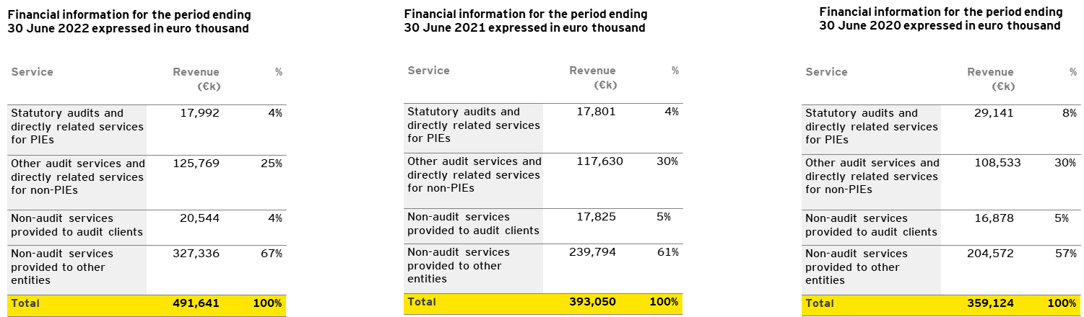
J.3 – Insurance & Financial Summary
As a private partnership in Ireland, EY is not subject to audit or filing requirements and the partnership does not make accounts available to third parties.
EY Ireland had revenues of €359.1M in FY20 , €393M in FY21, €491.6M in FY22
As an indication of the turnover in Ireland, EY makes available a Transparency Report which states our annual turnover. Our most recent Transparency Report can be found at EY Transparency Report 2022 | EY Ireland
If any further information is required to validate our financial standing, we can provide a banker’s reference letter, or our Country Managing Partner can provide a self-certification letter
Financial information Revenue represents combined, not consolidated, revenues, and includes expenses billed to clients and revenues related to billings to other EYG member firms. Revenue amounts disclosed in this report include revenues from both audit and non-audit clients. Revenue is presented in accordance with Statutory Instrument 312/3016 and included for:
Revenues from the statutory audit of annual and consolidated financial statements of PIEs, and entities belonging to a group of undertakings whose parent undertaking is a PIE
Revenues from the statutory audit of annual and consolidated financial statements of other entities
Revenues from permitted non-audit services to entities that are audited by the statutory auditor or the audit firm
Revenues from non-audit services to other entities

Slide 102
J.3 – Insurance & Financial Summary
Insurance Type | SJH Requirement |  | Levels held by Tenderer
Professional Liability | €6,500,000.00 |  | €6,500,000.00
Employers Liability | €12,700,000.00 |  | €13,500,000.00
Public Liability | €6,500,000.00 |  | €6,500,000.00
Copies of insurances to be included in submission | Should additional levels of insurance be required, are you prepared to put in place such levels as may be required by and agreed with the Contracting Authority? |  | Yes
Name of Insurer |  | AON UK Limited

Slide 103
K.
Certifications

Slide 104
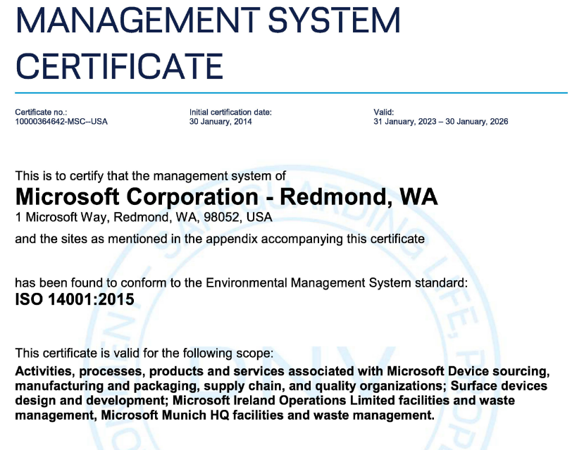
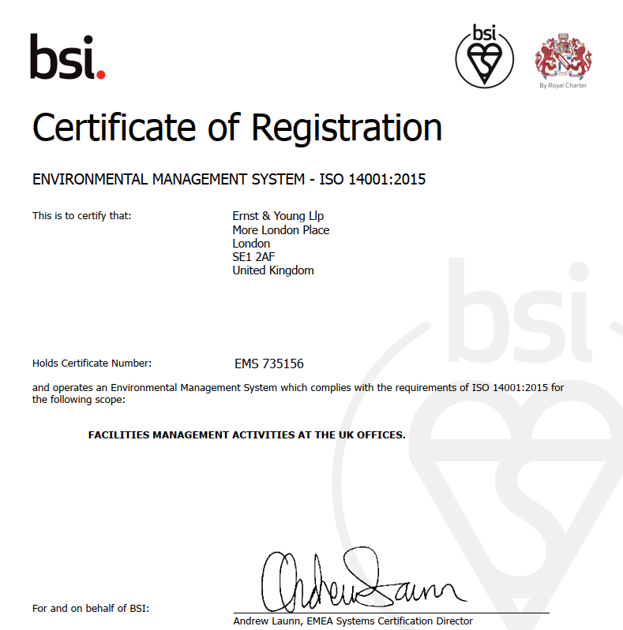
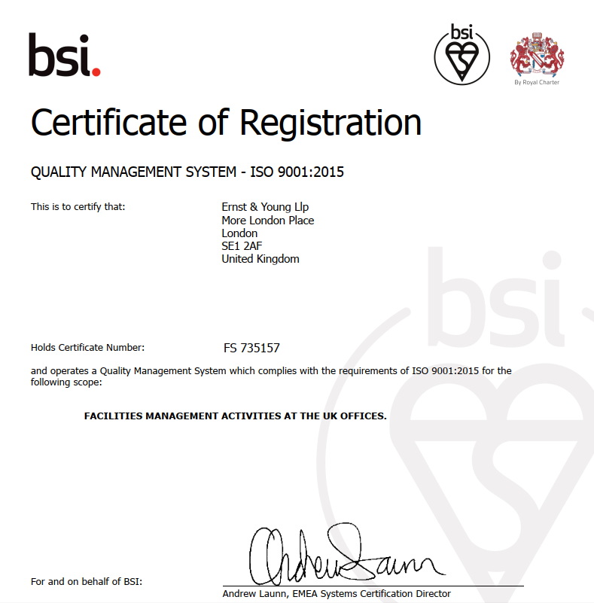
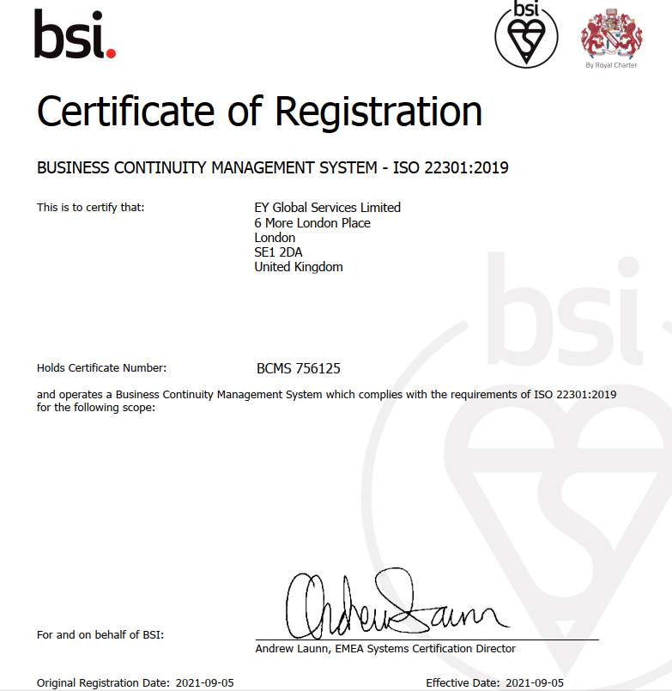
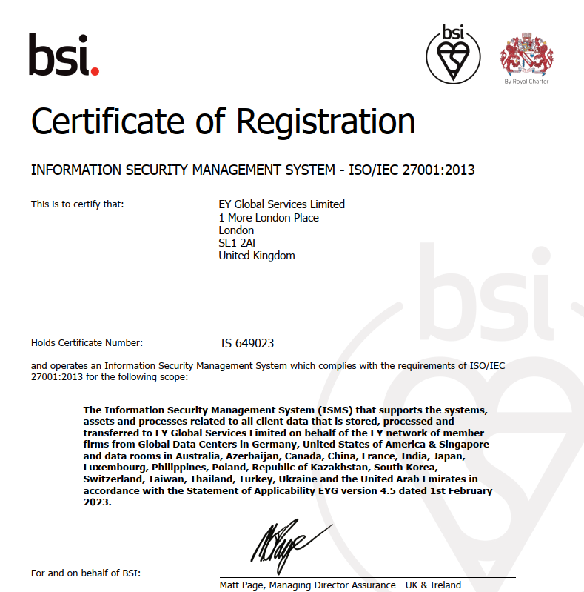
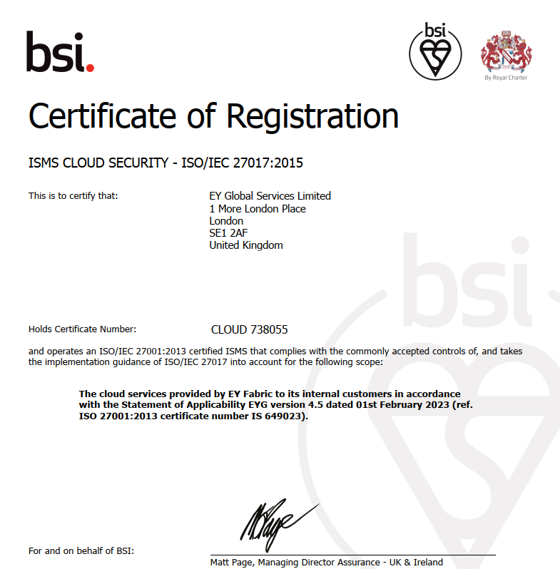
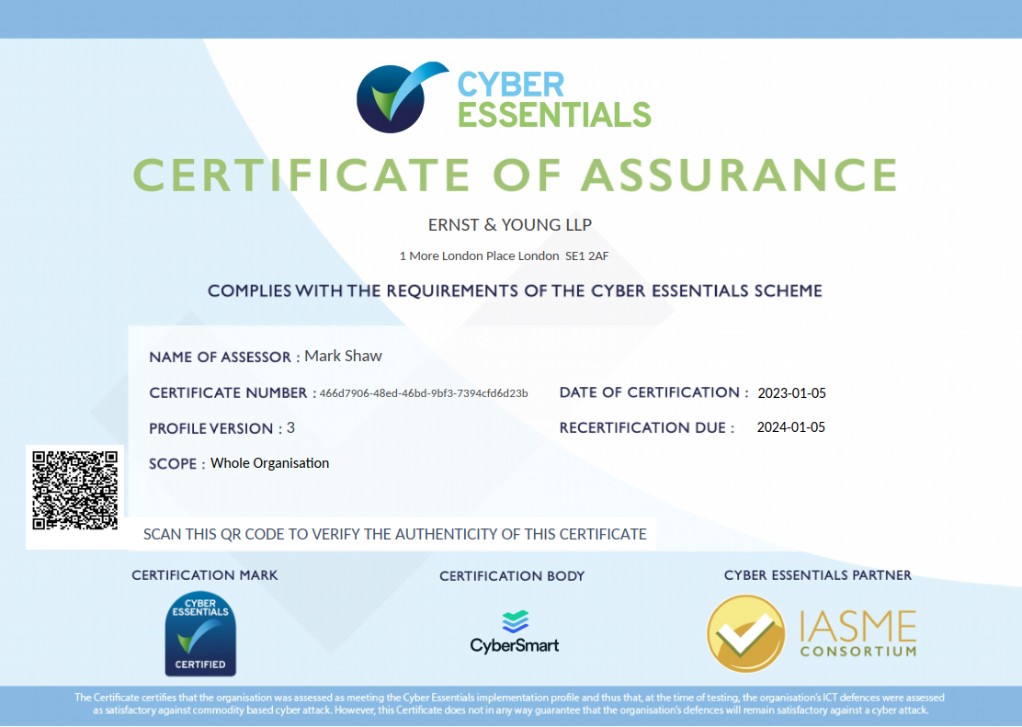
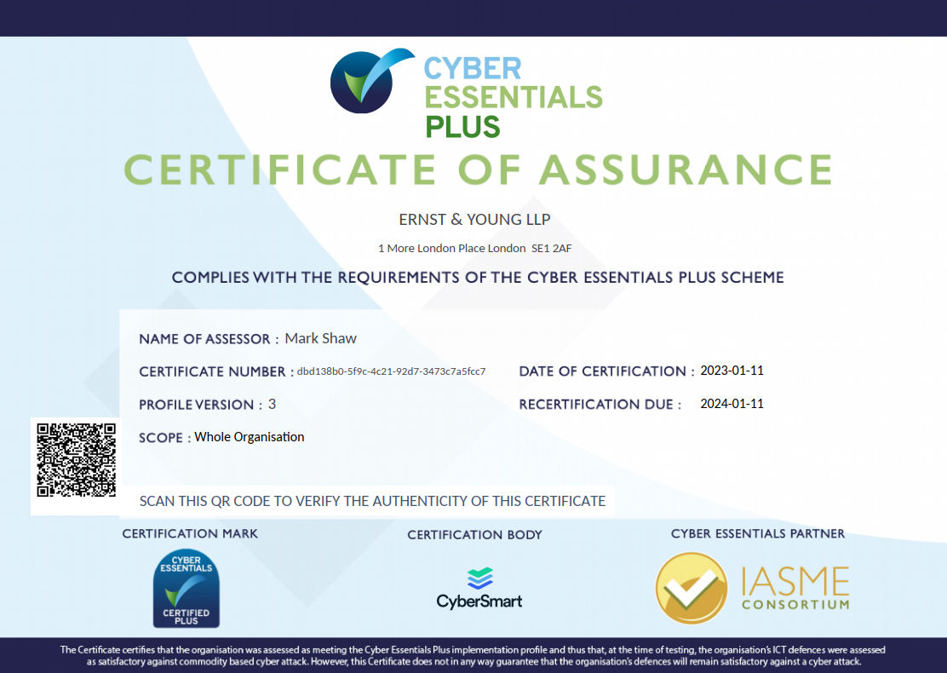
K.1 - ISO Certifications
ISO 14001
ISO 9001
ISO 22301
ISO 27001
ISO 27017
Certificate of Assurance – Cyber Essentials
Certificate of Assurance – Cyber Essentials Plus

Slide 105
L.
Appendix
L.1 – Table A (Overall Laboratory Hosting Requirements)
L.2 – Table B (Quality Management System Requirements)
L.3 – Table C (CMD)
L.4 - Table D (IMRL)
L.5 - Table E (NMRSARL)
L.6 - Table F (GCRL)
L.7 - Table G (HMD)
L.8 - Table H (Computing System Management)

Slide 106
L.1 – Table A (Overall Laboratory Hosting Requirements) Part 1
Item No. | Table A (Overall Laboratory Hosting Requirements) | Executive Response
1 | Refer to the existing Laboratory architecture and configuration (Appendix A) Solution should be based on the existing Microsoft Azure cloud services service in place to manage laboratory sequencing data using current SJH Corporate and Genomics networks. The proposed architecture should be designed to minimise risks to the SJH Corporate network. | The proposed EY solution is based on the current Azure tenant and existing infrastructure, and is designed to minimise risk across all requirement categories. Please review section D.
1.0.1 | The tenderer should retain connectivity for existing SJH users from the Azure cloud architecture to the SJH Corporate network. There should be no impact on existing setup. The tenderer should establish secure connectivity for new SJH users from the Azure cloud architecture to the SJH Corporate network in conjunction with the SJH IMS team. | The proposed EY solution does retain connectivity for existing SJH users from the Azure cloud architecture to the SJH Corporate network, and is designed to minimise risk across all requirement categories while improving on security processes in place currently. There will be no impact on the existing setup. Please review section D.
1.0.2 | The tenderer should retain connectivity for existing SJH users from the SJH Genomics network to the existing Azure cloud architecture for laboratory data. There should be no impact on existing setup unless agreed in advance. The tender should establish secure connectivity for new SJH users from the SJH Genomics network to the Azure cloud architecture for relevant analysers, data folders and personnel access, in conjunction with the IMS team. | The proposed EY solution does retain connectivity for existing SJH users from the SJH Genomics network to the existing Azure cloud architecture for laboratory data, and is designed to minimise risk across all requirement categories while improving on security processes in place currently. There will be no impact on the existing setup. Please review section D.
1.0.3 | The solution should virtualise existing on-site hardware in the most cost effective manner (as detailed per laboratory section). No hardware will be delivered as part of this solution. Manage all aspects of virtualisation process to the existing Azure cloud environment. | The proposed EY solution does provide a migration facility to virtualise existing on-site hardware in the most cost effective manner. Please review section D.
1.0.4 | The solution should allow SJH users to directly access the Azure cloud environment via a web portal connection (desktop icon) on their corporate PC. The solution should be accessible remotely from home (web based) onto SJH and Genomics network under existing SJH security access policies. | The proposed EY solution does provide a migration facility to virtualise existing on-site hardware in the most cost effective manner. Please review section D.
1.0.5 | The solution should allow SJH users to directly access both the SJH Corporate and SJH Genomics network from the existing Azure cloud environment. The ability to securely move files between the three environments is required (for example only, folder configuration to drag & drop files). | The proposed EY solution does allow SJH users to directly access the Azure cloud environment via a web portal connection (desktop icon) on their corporate PC. The solution does allow remote access from home (web based) onto SJH and Genomics network under existing SJH security access policies. Please review section D.
1.0.6 | The solution should deliver new web based Applications/software as listed per individual laboratory sections and include analyser device testing. User Acceptance Testing (UAT) will be required. | The proposed EY solution will provide the capability to deliver new web based Applications/software as listed per individual laboratory sections and include analyser device testing. Please review section D.
1.0.7 | The solution should retain existing SJH backup and Disaster Recovery architecture to maintain existing lab services with an alternative backup location within the EU. | The proposed EY solution will retain existing SJH backup and Disaster Recovery architecture to maintain existing lab services with an alternative backup location within the EU. Please review section D.
 | The solution should provide new SJH backup and Disaster Recovery architecture for new users/configuration/set up to maintain the service with an alternative backup location within the EU. | The proposed EY solution does provide new SJH backup and Disaster Recovery architecture for new users/configuration/set up to maintain the service with an alternative backup location within the EU. Please review section D.
1.0.8 | The solution should comply with existing SJH restoration processes for overall laboratory data. | The proposed EY solution will comply with existing SJH restoration processes for overall laboratory data. Please review section D.
1.0.9 | The solution should support a minimum of 30 concurrent users in 6 different laboratory areas/teams within the existing and under any new user/system configuration. | The proposed EY solution will support a minimum of 30 concurrent users in 6 different laboratory areas/teams within the existing and under any new user/system configuration, and is capable to scaling to provide support for greater numbers if and when required. Please review section D.
1.0.10 | The solution should build and provide all necessary virtual servers required to deliver rapid processing times in a cost effective manner and support routine laboratory processing of data. | The proposed EY solution will build and provide all necessary virtual servers required to deliver rapid processing times in a cost effective manner and support routine laboratory processing of data. Please review section D.
1.0.11 | The solution should provide monitoring of connectivity links for congestion and provide real-time alerting to client of monitors. | The proposed EY solution does provide monitoring of connectivity links for congestion and provide real-time alerting to client of monitors. Please review section D.

Slide 107
L.1 – Table A (Overall Laboratory Hosting Requirements) Part 2
Item No. | Table A (Overall Laboratory Hosting Requirements) | Executive Response
1.0.12 | The solution should provide any new data storage configuration required to support new laboratory testing services within the Azure environment. This includes the movement of laboratory files between on-site and virtual servers, analysers files, and retrieval/access to archive files. | The proposed EY solution will provide any new data storage configuration required to support new laboratory testing services within the Azure environment. This includes the movement of laboratory files between on-site and virtual servers, analysers files, and retrieval/access to archive files. Please review section D.
1.0.13 | The solution should provide the necessary systems and tools required to manage, monitor, and secure the LabMed Molecular Cloud environment configuration | The proposed EY solution will provide the necessary systems and tools required to manage, monitor, and secure the LabMed Molecular Cloud environment configurations. Please review section D.
1.0.14 | The solution should provide systems required (e.g. Domain Controllers) for explicit logon authentication in order to support communication with Client Active Directory Services within Azure environment, where not already in place. This includes new users and ongoing management of users at SJH as well as new Directory services within Azure. | Based on SJH response ( clarification questions ) we are not going to build any DC on the cloud. However, we are going to rely on the current setup ( On-Prem DC and Azure AD for authentication and authorization )
1.0.15 | The solution should comply with SJH Security requirements and support existing user authentication processes within Azure (e.g. rotation of user passwords, MFA) | The proposed EY solution does comply with SJH Security requirements and support existing user authentication processes within Azure (e.g. rotation of user passwords, MFA).
1.0.16 | The tenderer should provide maintenance support and apply security/critical/application patches for the in-scope systems for new virtual system and if applicable, any physical systems on-premise: dedicated hotline/helpdesk manned Monday to Friday 9am to 5pm is required | The proposed EY solution will provide maintenance support and apply security/critical/application patches for the in-scope systems for new virtual system and if applicable, any physical systems on-premise: dedicated hotline/helpdesk
1.0.17 | The tenderer should manage all aspects of user specific log-in details (username and passwords) for new and existing users, which are unique to individual laboratory users while retaining access to shared folders/pathways. Includes user access to web based software for laboratory personnel. | The proposed EY solution will manage all aspects of user specific log-in details (username and passwords) for new and existing users, which are unique to individual laboratory users while retaining access to shared folders/pathways. Includes user access to web based software for laboratory personnel.
1.0.18 | The tenderer should build upon existing architecture (termed Phase 1 locally) and establish both hot and cold archive storage processes for existing and new laboratory data. This includes managing (automatic scheduling and manual archive processes) for users. | The proposed EY solution does build upon existing architecture (termed Phase 1 locally) and establish both hot and cold archive storage processes for existing and new laboratory data. This includes managing (automatic scheduling and manual archive processes) for users.
1.0.19 | The solution should allow users to delete laboratory data from the Azure archive storage folders based on individual user access, using both automatic scheduling and manual deletion processes. Unauthorised users should not be capable of deleting data from other laboratory areas. | The proposed EY solution will allow users to delete laboratory data from the Azure archive storage folders based on individual user access, using both automatic scheduling and manual deletion processes. Unauthorised users should not be capable of deleting data from other laboratory areas.
1.0.20 | All data including backup data should reside in the EU and be secured. | The proposed EY solution does backup all data held withing the proposed solution within the EU solely.
1.0.21 | The solution should perform routine system and database backups and store backup files in a manner that will protect the confidentiality of the data | The proposed EY solution does perform routine system and database backups and store backup files in a manner that will protect the confidentiality of the data.
1.0.22 | The solution should protect against unauthorized or unlawful access, use, disclosure, alteration, or destruction of Client data. Process to be described. | The proposed EY solution does protect against unauthorized or unlawful access, use, disclosure, alteration, or destruction of Client data. Please see section D.
1.0.23 | The solution should include automated deployment of infrastructure as required by the laboratory team including automated processed for start-up and shutdown of virtual instances and automatic scripts for scheduled tasks. Process to be described. | The proposed EY solution does include automated deployment of infrastructure as required by the laboratory team including automated processed for start-up and shutdown of virtual instances and automatic scripts for scheduled tasks.
1.0.24 | All tenders must deliver a project plan, architectural desgn document and project timeline (Gantt chart or equivalent) for the solution | The proposed EY solution does provide a project plan, architectural design document and project timeline for the solution.

Slide 108
L.2 – Table B (Quality Management System Requirements)
Item No. | Table B (Quality Management System Requirements) | Executive Response
2.1 | The solution should be compatible with ISO 15189: 2012 and ISO 15189:2022 requirements. This includes quality management system requirements for Vendor Acceptance Testing as determined by the Quality Manager at SJH. | As per the requirements, the proposed solution utilises several services within the Azure suite of services. Azure as a platform does meet all required ISO standards. Please review section D which provides details of our approach to Quality Assurance and Testing Methodology. Please review section G which provides details of the Quality Management System, compatibility to ISO standards and Test Quality Management Plan in regards to Quality Control.
2.2 | The solution will be assessed during visits from the Irish National Accreditation Board (INAB) and technical support during these visits is required. Timelines for assessments are confirmed in advance to allow sufficient time to schedule on-line sessions. There is no requirement for on-site support in this regard. | In line with the requirements, the proposed solution does provide remote managed services support. Section E outlines EY Technical Support availability in greater detail.
2.3 | Validation documentation and supplementary documentation (e.g. screen prints) are required as evidence of vendor acceptance testing and should be approved to the SJH Laboratory Manager and Quality Manager. | As per the requirement Section D provides details of our Testing Methodology. Section G provides details of the Quality Management System and Test Quality Management Plan in regards to Quality Control. All required proof of testing outcomes will be provided.
2.4 | The tenderer should partake in audits (e.g. access, Disaster recovery etc.) of the cloud solution in conjunction with the Quality Manager and/or Laboratory ICT Manager. | Section G provides information in regards to the extensive collaboration during audits, penetration tests, UAT, training plans and documentation approvals and anywhere else we will be working with SJH to ensure to maintain a high quality QMS.
2.5 | The tenderer should provide evidence of compliance with any ISO accreditation standards, implementation of a quality management system and compliance with legislative standards (e.g. Data Protection Acts 1988 and 2003). | Section G includes information on ISO accreditation standards.
2.6 | Documentation to describe how to use & manage the system should be provided e.g. SOP/manual/operating instruction | Section F details what will be completed in regards to Training and Knowledge Transfer of the solution and ongoing training and, as and when changes are planned, pre and post implementation.
2.7 | The tenderer should provide initial and on-going training in the use of the system to SJH users. Documentation to support same should be provided. | Section F details what will be completed in regards to Training and Knowledge Transfer of the solution, initial and ongoing training and, as and when changes are planned, pre and post implementation. This includes documentation that will produced.
2.8 | The tenderer should facilitate an independent security review (penetration testing) undertaken by a specialist company contracted by SJH. Tenders should cooperate fully with the appointer contractor and SJH in order to ensure prompt execution of the review on multiple occasions (e.g. prior to go-live, post go-live). The tenderer will work with SJH, the contracted company and other third parties to resolve any security issues identified. | Section G - QMS provides information on EY facilitating an independent security review.

Slide 109
L.3 – Table C (CMD) Part 1
Item No. | Table C (CMD) | Executive Response
3.1 | The tenderer should migrate current Windows 2012 server (herafter referred to as ‘JSI Server’ to cloud instance with upgraded server operating system and increased processing power (96Gb RAM, >32 threads @ >3.0 Ghz, 4Tb expandable local storage) - Cloud instance to be added to current Azure cloud backup solution - Rolling weekly and monthly snapshots to be created and a capability to roll back to last-known good should also be included and documented. - The laboratory should also be able to initiate on-demand system snapshots with a custom specified retention time. - The JSI server should be included in the corporate subnet of the cloud installation. - JSI server must be hardened to only required services to deliver the service. - JSI server must have AV and be capable of being remotely monitored. - The current JSI client-server infrastructure (using shared folders) should be maintained or an alternative approach that allows current client-side software to operate without the requirement for remote-desktops should be provided. - The JSI server should be able to use secure file transfer protocols to retrieve data files from the corporate and non-corporate networks. Network access rules should be configured to support this activity. - The JSI server should be supported by a relevant support service contract. | The proposed EY solution will migrate current Windows 2012 server workloads (hereafter referred to as ‘JSI Server’) to a cloud instance which utilises the Windows server 2022 operating system. The proposed EY solution does ensure this server is backed up via the Azure Backup Center. The resource will be accessible from all networks which require access to it. The resource will have access to all required secure file shares. The resource will be fully supported at both a vendor platform level and managed service level. Please see section D of the tender response documentation for more details.
3.2 | The CMD laboratory should be able to initialise custom VM instances within its own cloud subnet and accessible from the SJH corporate network. VM instances within the development and pre-production environments (see below) should have access to operating system and software updates from typical sources such as Ubuntu apt repositories, GitHub, PyPi.org etc. - Instances should be capable of being initiated within pre-defined sandboxes/environments (development, pre-production and production) - The laboratory should be able to create snapshots and backups of instances as needed. - The instances within the production environment should be have access permissions to function as servers for files that will be downloaded by the JSI server (see 2.1) - The network that the instances will reside on should be secured to ensure that connections to the SJH corporate network are not permitted. - A scheduler should be available to start and stop selected instances. - Custom billing notifications should be available to notify users when costs exceed pre-set limits. - Instances within the ‘production’ environment should be secured by default to have only the minimal connectivity required in order to serve pre-tested functionality. Access to third-party software, updates and upgrades should not be possible for instances within the production environment (instances should be upgraded and tested in pre-production and ‘copied’ into the production environment unchanged). We are open to discussion on this to ensure compliance with security best practice. | The proposed EY solution will facilitate for the initialisation of custom VM instances within the CMD subnet which, will be accessible from the SJH corporate network. VM instances within the development and pre-production environments will have access to operating system and software updates from typical sources such as Ubuntu apt repositories, GitHub, PyPi.org etc via, Golden image patch management. The proposed solution will facilitate Instances being initiated within pre-defined sandboxes/environments (development, pre-production and production), and the certation of snapshots and backups as needed. The proposed solution does facilitate VM instances in the production environment to function as servers and files that will be downloaded by the JSI server can be saved onto a predefined network share which is mapped. The proposed solution will have secure network segregation and traffic shaping in place to ensure they are accessible from required cloud and on-prem networks. The proposed solution will utilised Azure schedulers to start and stop compute resources where required to do so, and the solution does provide billing notifications to notify users when costs exceed pre-set limits. The proposed solution does ensure that all ‘production’ environment workloads are heavily secured and have minimal connectivity in order to serve required processes and functionality. Third-party software, updates, and upgrades will not be available for VM instances in production until heavily tested in pre-production VM workloads first. Following successful testing such software, updates, and upgrade will be pushed to production workloads.

Slide 110
L.3 – Table C (CMD) Part 2
Item No. | Table C (CMD) | Executive Response
3.3 | A working storage and backup solution should be created for the cloud instances in 3.1 & 3.2 above. Three storage ‘areas’ should be created for each sandbox (from development, pre-production and production). Each storage area should be accessible by instances within the same ‘area’. - A mechanism should be made available to copy files to different storage areas without granting access to instances from outside of the controlled area. | The proposed EY solution will facilitate the creation of several Azure storage location for use with dev/test/prod environments which will be accessible from their relevant environment and no where else. The proposed solution will allow from the copying of files to different storage locations, without granting access to instances from outside of the controlled area, by predefined and approved personal. The "Azure storage explorer" application will facilitate the transfer of files by approved personal with its GUI interface.
3.4 | One instance each of the following should be pre-configured and available within the non-corporate network: 3.4.1 Azure Database for PostgreSQL, flexible server (production (small/medium size) / daily back-up) 3.4.2 Azure Database for PostgreSQL, flexible server (development / weekly back-up) 3.4.3 Azure Linux VM (Ubuntu server) with Docker integration to self-host Appsmith (production / daily back-up) 3.4.4 Azure Linux VM (Ubuntu server) with Docker integration to self-host Appsmith (development / weekly back-up) 3.4.5 Azure Linux VM (Ubuntu server) (sandbox) | The proposed EY solution will facilitate one VM instance from each environment to be available within the non-corporate network: 3.4.1 Azure Database for PostgreSQL, flexible server production 3.4.2 Azure Database for PostgreSQL, flexible server development 3.4.3 Azure Linux VM (Ubuntu server) with Docker integration / Appsmith production 3.4.4 Azure Linux VM (Ubuntu server) with Docker integration / Appsmith development 3.4.5 Azure Linux VM (Ubuntu server) (sandbox) All VM workloads will be backed up meeting defined backup requirements.
3.5 | Private code repository (GitLab preferred) accessible on the corporate and genomics network | The proposed EY solution will facilitate private code repository (GitLab preferred) access on corporate and genomics networks.

Slide 111
L.4 – Table D (IMRL)
Item No. | Table D: Irish Mycobacteria Reference Laboratory (IMRL) | Exec Response
4.1 | The solution should provide a Linux Virtual Machine (VM) with a graphical user interface (ie. Ubuntu) required and needs to have equivalent (or greater) specifications as the IMRL Linux PC on the SJH genomics network as follows: The IMRL linux PC currently has Ubuntu 18.04.6 LTS 64-bit operating system, 128GB RAM, 18 core processor, 11GB Graphics card, and 4 TB local storage disk. This is required to run scripts for command line analysis (ie.MTBseq, TBprofiler, NTMprofiler, Kraken2, snippy, snp-dists, FastP etc). If equivalent Azure command line software is applicable, vendor to provide details. | EY had noted the required compute and storage resources, and we will create an Azure VM ( Ubuntu Pro 18.04 / Ubuntu Server 22.04 ) which supports that need, also we will list all the needed / mentioned applications and work with SJH to install them
4.2 | The solution should provide a Linux VM to run GUI software including Seqsphere, RaxML, LibreOffice, gedit. This is required to perform analysis and read/write files such as .txt, .tab, fastq, .csv .gz, .vcf, etc. | EY had noted the required compute and storage resources, and we will create an Azure VM ( Ubuntu Pro 18.04 / Ubuntu Server 22.04 ) which supports that need, also we will list all the needed / mentioned applications and work with SJH to install them
4.3 | Microsoft office is currently installed through a windows virtual box on the IMRL linux PC and data from analysis files are copied/pasted into a Microsoft Access database. Vendor to implement Azure hosting of an alternative database solution to the current Microsoft access database for data management to deliver a new process/ solution. This includes migration of data from existing Microsoft Access database to the new proposed solution (for example .NET or SaaS solution) which is secure from a data protection perspective. | EY will assess the current DB that is in place and will follow Microsoft best practices to migrate the Access DB's to Azure SQL DB Server.
4.4 | The solution must provide access to web browser and external websites (ie. google, github, conda, NCBI, Basespace, iTOL etc) from the Linux VM to download files for analysis and admin privileges required to install software and command line tools. We require advise and mitigations around the use of some of these tools and risks associated to services. A change control process will need to be developed for the installation of software and tools. This is required to update software tools used in the IMRL as part of on-going service development. | Azure Firewall will be part of our proposed solution and using it we will define / list the needed URLs to allow the access to them
4.5 | The solution should provide a Linux VM with graphical user interface requires access to the IMRL Azure storage server (shrdnestg001) with admin privileges to view, edit and write. This is required for direct access to long term storage files. | EY had noted the requirement here and we will facilitate and avail that.
4.6 | The solution should provide secure access to Linux VM from SJH Genomics network to the SJH Corporate network and allow transfer of analysis files (upload and download) between both networks (file sharing processes). This may involve file updates mid-process. | Connectivity to the proposed solution will be achieved by utilising an Azure vWAN Hub which consists of an Azure Firewall and Azure Virtual Network Gateway which will help us to comply with SJH policies on security and access
4.7 | The solution should allow the Linux VM to sit on SJH genomics network and process MiSeq files locally on this Genomics network. The MiSeq sequencer is currently on the genomics network and this is required to process sequencing files to the Linux VM within this network. | Connectivity to the proposed solution will be achieved by utilising an Azure vWAN Hub which consists of an Azure Firewall and Azure Virtual Network Gateway which will help us to comply with SJH policies on security and access
4.8 | The solution should be compatible with SJH remote access to the Azure environment and the Genomics network including the Linux VM directly from a local PC. Connectivity should be in line with SJH policies on security and access. | As highlighted in the previous point (4.6) our solution will comply with SJH policies on security and access.

Slide 112
L.5 – Table E (NMRSARL) Part 1
Item No. | Table E: National MRSA Reference Laboratory (NMRSARL) | Exec Response
5.1 | Direct upload from MiSeq to MRSARL portal on Azure. Confirmation that bandwidth does not impact file transfers. Data storage folders for existing and new processes to be supported and implemented. | During the discovery phase, EY will analysis the current configurations and process to provide the best solution for this task and avoid any impact when it comes to the file transfer.
5.2 | Azure VM with a graphical user interface (ie Ubuntu) with at least Ubuntu 18.04.6 LTS 64-bit operating system, 128GB RAM, 18 core processor, 11GB Graphics card, and 4 TB local storage disk. Software to be installed in the Azure VM to include Kraken2, Snippy, snp-dists, FastP, mlst, bowtie2, minimap2, samtools, mafft, figtree, Jalview, Seqsphere, RaxML, LibreOffice, MTBseq, TBprofiler and NTMprofiler. Ability to download and install updates to any of the software as the need arises. It should be noted that this list may expand during the tendering process depending on the needs of the lab during the tender period but all software used in the laboratory is available on Github or on licenced software held within the laboratory. We require advise and mitigations around the use of some of these tools and risks associated to services. A change control process will need to be developed for the installation of software and tools. | EY had noted the required compute and storage resources, and we will create an Azure VM which supoorts that need, also we will list all the needed / mentioned applications and work with SJH to install them
5.3 | A secure solution with the ability to view, edit, move and download files generated by software installed on the above mentioned Azure VM (eg .txt., tab, fastq, .csv .gz, .vcf, etc.). This includes the ability to edit files on the Azure portal without downloading and uploading new versions. It may also include moving files within the Azure VM, the storage server and the corporate network. (Fileshare does not allow editing of files on Azure portal). | The proposed solution by EY will utilise or leverage Azure Storage Explorer to cover this point
5.4 | Access to web browser and external websites (ie. google, github, conda, NCBI, Basespace, iTOL, AnyDesk, PubMLST, CARD, EpiSeq etc) from the Azure VM with an ability to download reference sequences for inclusion in some data analysis and to upload above mentioned data files for analysis. We require advise and mitigations around the use of some of these tools and risks associated to services. A change control process will need to be developed for the installation of software and tools. | Azure Firewall will be part of our proposed solution and using it we will define / list the needed URLs to allow the access to them
5.5 | Replacement of an existing Microsoft Access database with an alternative solution in the Azure environment which can be accessed by all laboratory users for data management. This includes migration of data from existing Microsoft Access database to the new proposed solution (for example .NET or SaaS solution) which is secure from a data protection perspective. | EY will assess the DB that is in place and will follow Microsoft best practices to migrate the Access DB's to Azure SQL DB Server.
5.6 | A secure solution with the ability to download result files from the Azure environment to the SJH Corporate network in line with SJH policies on security and access. | The proposed solution by EY will utilise or leverage Azure Storage Explorer to cover this point

Slide 113
L.5 – Table E (NMRSARL) Part 2
Item No. | Table E: National MRSA Reference Laboratory (NMRSARL) | Exec Response
5.7 | A secure solution with the ability to replicate current pipelines on Azure environment. This may include automation of some scripts in the Azure VM environment. | EY had noted the requirement and will provide that as part of our proposed solution.
5.8 | Assessment of timelines for upload of files from the instruments hosted on the Genomics network (MiSeq) / download of files from the Azure environment to the corporate network. | Providing a timeline for moving files really depends on a lot of factors like the overall size of transferred files, type of files, and the network utilization during that time, such info can be assessed and provided during the discovery phase
5.9 | Support/ training/ credentials to allow updating of software and management of Laboratory VM solution. | EY will use Azure update manager to manage OS updates, and at the same time we will work with / support SJH and their vendors to manage the updates of the current software
5.10 | A secure remote access solution to the SJH azure portal for analysis | The proposed solution will cover this point, as all the communication will be managed by a secure IPsec VPN Tunnels and the traffic will be managed by Azure Firewall as well
5.11 | Ability to utilise multiple different VM for analysis purposes depending on work in the laboratory. Eg a different VM for analysis of each different organism with previously software installed on each. | EY will provide the needed Azure resources whenever that will be needed.
5.12 | Transfer of SeqSphere server from local windows laptop to azure environment. | The proposed solution by EY can utilise or leverage Azure Storage Explorer to cover this point

Slide 114
L.6 – Table F (GCRL)
Item No. | Table F: Gonococcal Reference Laboratory (GCRL) | Exec Response
6.1 | Direct upload from MiSeq to MRSARL portal on Azure. Confirmation that bandwidth does not impact file transfers. Data storage folders for existing and new processes to be supported and implemented. | During the discovery phase, EY will analysis the current configurations and process to provide the best solution for this task and avoid any impact when it comes to the file transfer.
6.2 | Access to Linux VM with a graphical user interface (ie. Ubuntu) required and needs to have equivalent (or greater) specifications as the IMRL Linux PC on the SJH genomics network as follows: The IMRL linux PC currently has Ubuntu 18.04.6 LTS 64-bit operating system, 128GB RAM, 18 core processor, 11GB Graphics card, and 4 TB local storage disk. This is required to run scripts for command line analysis (ie res finder, MLST, Kraken2, snippy, snp-dists, FastP, seqsphere etc). If equivalent Azure command line software is applicable, vendor to provide details. | EY had noted the required compute and storage resources, and we will create an Azure VM which supoorts that need, also we will list all the needed / mentioned applications and work with SJH to install them
6.3 | Ability to view, edit, move and download files generated by software installed on the above mentioned Azure VM (eg .txt., tab, fastq, .csv .gz, .vcf, etc.). This includes the ability to edit files on the Azure portal without downloading and uploading new versions. It may also include moving files within the Azure VM, the storage server and the corporate network. (Fileshare does not allow editing of files on Azure portal). | The proposed solution by EY will utilise or leverage Azure Storage Explorer to cover this point
6.4 | Access to web browser and external websites (ie. google, github, conda, NCBI, Basespace, iTOL, AnyDesk, PubMLST, CARD, EpiSeq etc) from the Azure VM with an ability to download reference sequences for inclusion in some data analysis and to upload above mentioned data files for analysis. This is required to update software tools used in the GCRL as part of on-going service development. We require advise and mitigations around the use of some of these tools and risks associated to services. A change control process will need to be developed for the installation of software and tools. | Azure Firewall will be part of our proposed solution, and using it we will define / list the needed URLs to allow the access to them
6.5 | Create a patient database solution in the Azure environment which can be accessed by all laboratory users for data management. No current access data base in GCRL (future project) which is secure from a data protection perspective. | Microsoft Access will be migrated to SQL Server. PostgreSQL and MySQL will be migrated to Azure’s cloud equivalents. EY also notes the need for a new patient database solution for GCRL, which may require some design thinking on the appropriate underlying technologies to line up to the type of testing performed by the lab (e.g., document-type database vs SQL)
6.6 | A secure solution with the ability to download result files from the Azure environment to the SJH Corporate network in line with SJH policies on security and access. | The proposed solution by EY can utilise or leverage Azure Storage Explorer to cover this point
6.7 | Secure remote access solution to SJH azure portal for analysis. Be compatible with SJH remote access to the Azure environment and the Genomics network including the Linux VM directly from a local PC. Connectivity should be in line with SJH policies on security and access | Connectivity to the proposed solution will be achieved by utilising an Azure vWAN Hub which consists of an Azure Firewall and Azure Virtual Network Gateway which will help us to comply with SJH policies on security and access
6.8 | Support/ training/ credentials to allow updating of software and management of Laboratory VM solution. | EY will use Azure update manager to manage OS updates, and at the same time we will work with & support SJH and their vendors to manage the updates of the current software

Slide 115
L.7 – Table G (HMD)
Item No. | Table G: Haemostasis Molecular Diagnostics (HMD) Laboratory | Exec Response
7.1 | The HMD laboratory is currently not connected to the Microsoft Azure cloud hosted environment. The tenderer will be required to engage with the HMD and align their data storage configuration with the CMD laboratory (Table C) including JSI connectivity in Azure (new) and connectivity to new laboratory folders/files. | EY will work with and support HMD laboratory to define their requirements and needs

Slide 116
L.8 – Table H (Computing Systems Management) Part 1
Item No. | Table H: Computing Systems Management | Exec Response
8.1 | Monitor and maintain database health, availability, and performance. The desired service should be available as needed by laboratory users at all time and not be offline in any regard other than under disaster conditions. | EY will rely on Azure Monitor, Query Performance Insight, and Azure resource health to handle this part.
8.2 | Monitor and maintain database storage requirements (e.g. storage, usage, etc.) The desired storage service should be available as needed by laboratory users at all times and not be offline in any regard other than under disaster conditions. | EY will rely on Azure Monitor, Query Performance Insight, and Azure resource health to handle this part.
8.3 | Manage database level access (e.g., user accounts and privileges). Client approval needed for CCL/super user level access. | EY has noted the requirements, and we will comply with the current approval process
?? | In conjunction with third party vendors complete software upgrades, assess the impact and the requirement for re-validation to be performed. Support the laboratory teams & IMS in the completion of same. | EY will work with & support SJH and their vendors to manage the updates / upgrades of the current software and set a clear process to validate everything before applying any change on the PROD environment.
8.4 | Perform technical work required to support patch installs and database upgrades. All works should be scheduled at least 2 weeks in advance of any proposed changes with relevant documentation provided for our Quality management system. All upgrades should be completed within an agreed timeframe which will be set at the time of contract/service agreement with SJH personnel. | EY had noted the requirements to support patch installs and database upgrades while considering the agreed time frame
8.5 | Perform technical troubleshooting and support of database. A helpdesk within the EU will be required. All details relating to troubleshooting and technical support will be agreed with the successful vendor at the time of contract/service agreement completion with SJH personnel. | EY will provide a Managed Service to provide technical support and troubleshooting of any issues reported to them or notified from the application/platform monitoring, including databases. Details of this can be found within Section C - Managed Services.

Slide 117
L.8 – Table H (Computing Systems Management) Part 2
Item No. | Table H: Computing Systems Management | Exec Response
8.7 | Provider shall maintain business resilience/disaster recovery plans for the solution provided. A business continuity/disaster recovery plan should be provided by the vendor including time to restoration of services and time to recovery of data. | EY has noted the requirements, and this point is well detailed under D1 section
8.8 | Provide auditing reporting and alerting for solution, these can include add/moves/deletes/login/failed login/backups/failed backups etc | As highlighted before, EY will achieve that by using Sign-in logs in Azure Active Directory - Microsoft Entra & Azure Monitor.
8.9 | Must comply with SJH password policy | EY had noted the requirements and we will comply with the current password policy
8.10 | Individual user accounts must be used, all root accounts to have strong passwords and reset every 90 days. | EY had noted the requirements and we will comply with the current policies
8.11 | Full documentation to be produced of final solution on completion of setup. | EY will provide a full documentation which covers and explains every aspect of the platform
8.12 | Ability to display the Azure costs per Laboratory | The cost of the Azure resources will be managed using Azure Cost Management and we can split or display the cost per laboratory via applying Azure policy or using azure resource tags

